Slide 1
U.S. Census Bureau Urban Area Definition
Absolute minimum – at least 5,000 people or 2,000 housing units.
Nucleus – at least one block with 1,275 housing units per square mile.
Urban core – blocks near nucleus with 425 housing units / sq. mi.
Urban area – blocks near core with 200 housing units / sq. mi.
Binary – each census block is either “urban” or “rural”.
“near” – 1.5 miles or less (intervening blocks not included)
Source: https://www.census.gov/newsroom/blogs/random-samplings/2022/12/redefining-urban-areas-following-2020-census.html

Slide 2
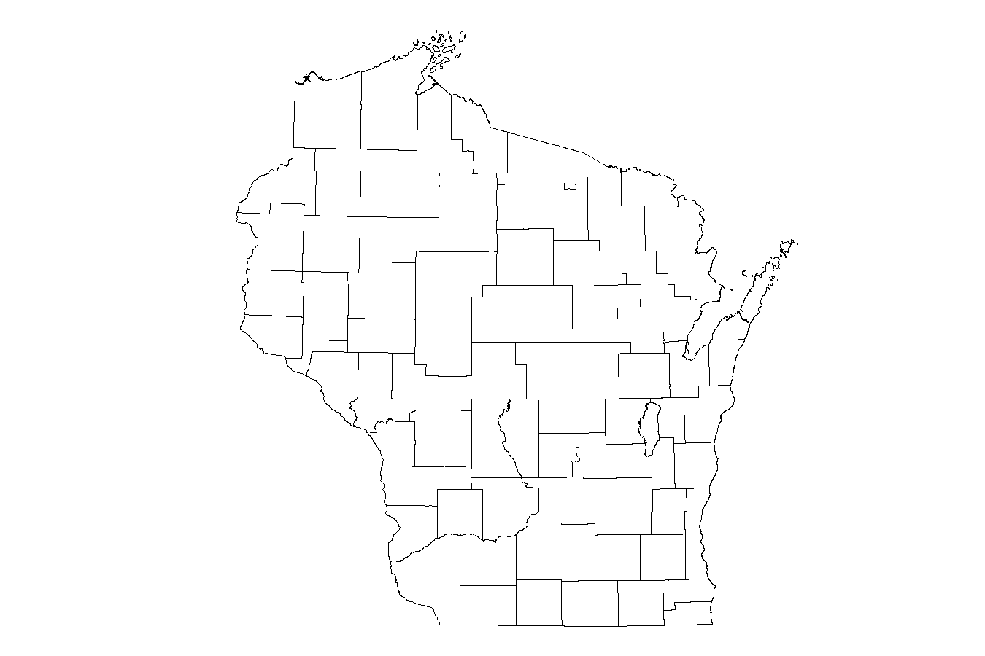
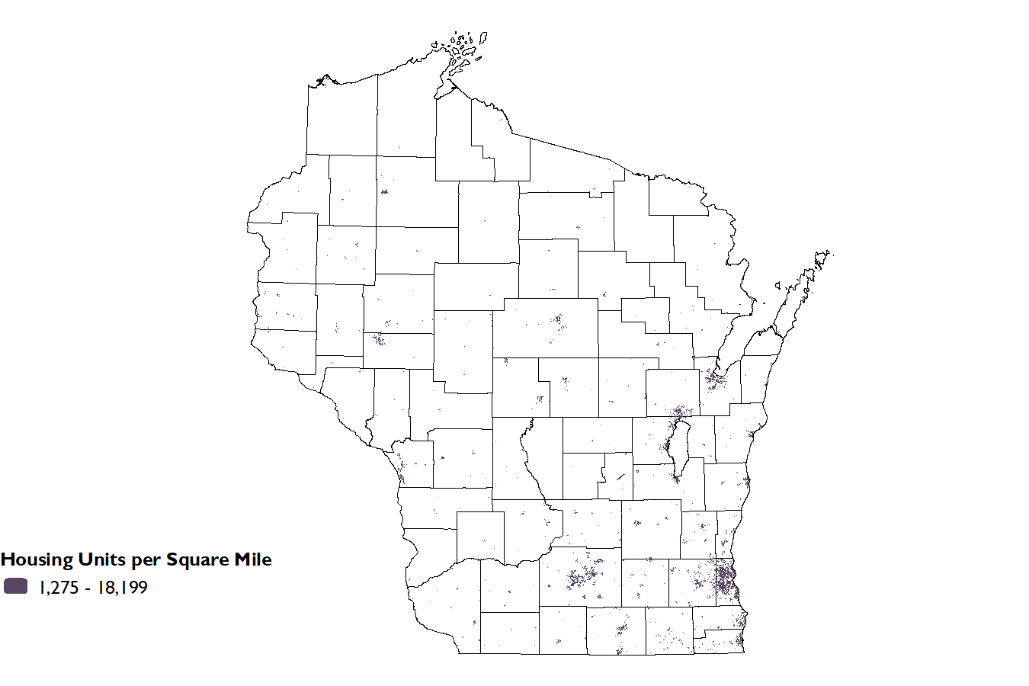
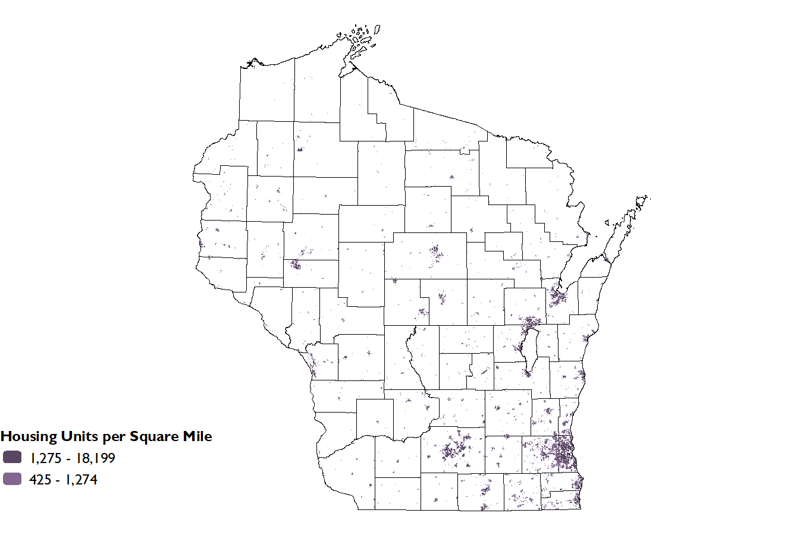
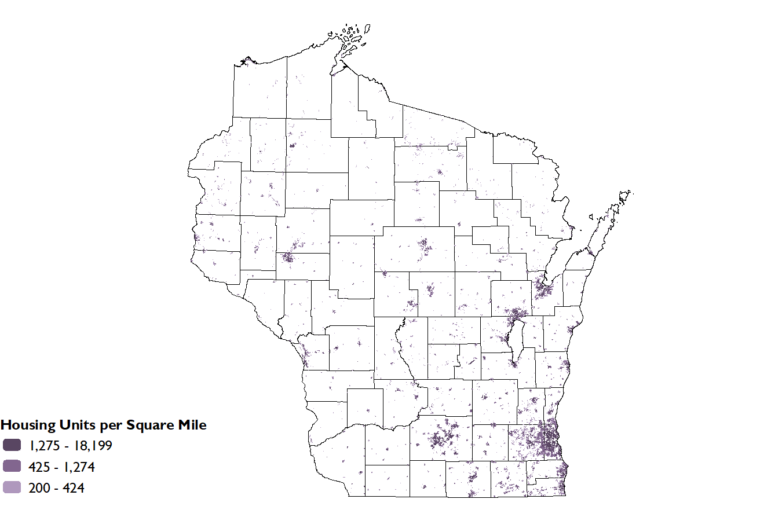
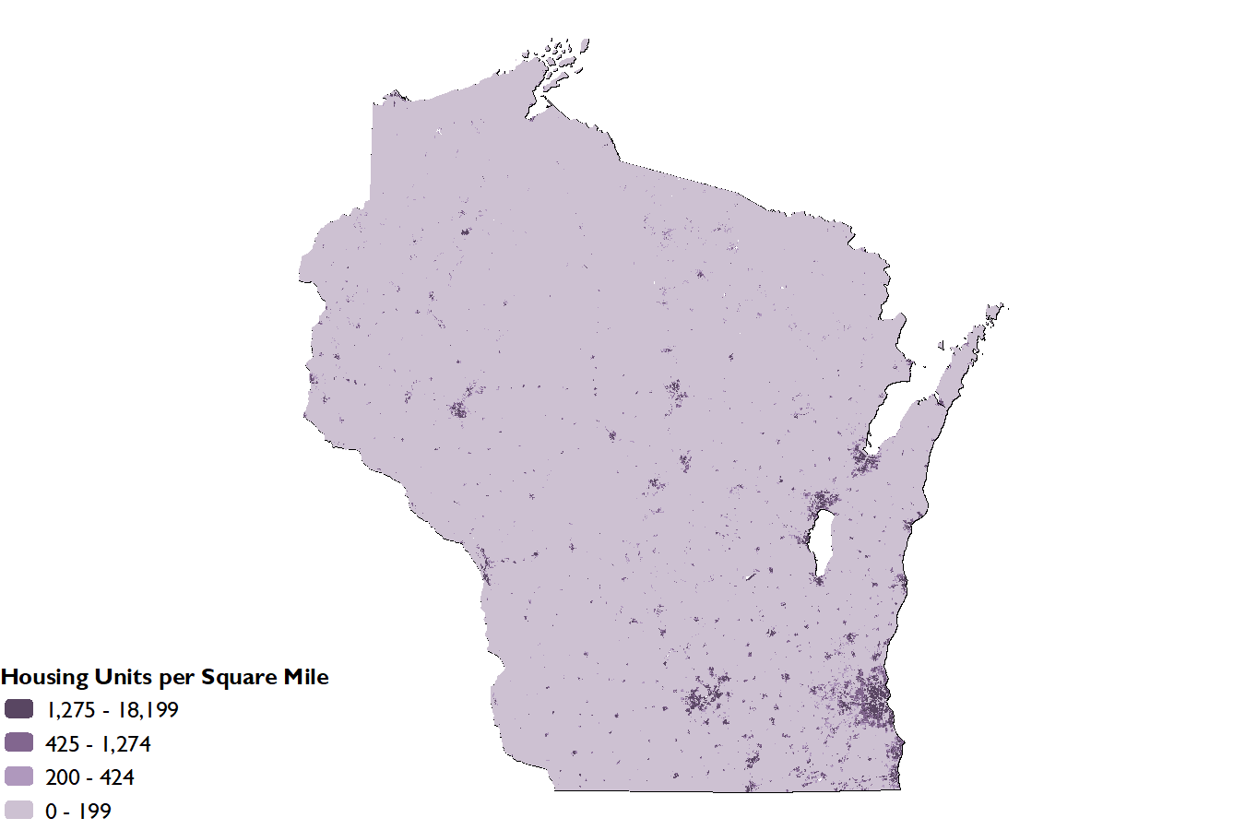
Housing Units per Square Mile
Sources: 2020 Census Table H2, Urban and Rural https://data.census.gov/advanced and
Census TIGER shapefiles for land area
https://www.census.gov/cgi-bin/geo/shapefiles/index.php

Slide 3
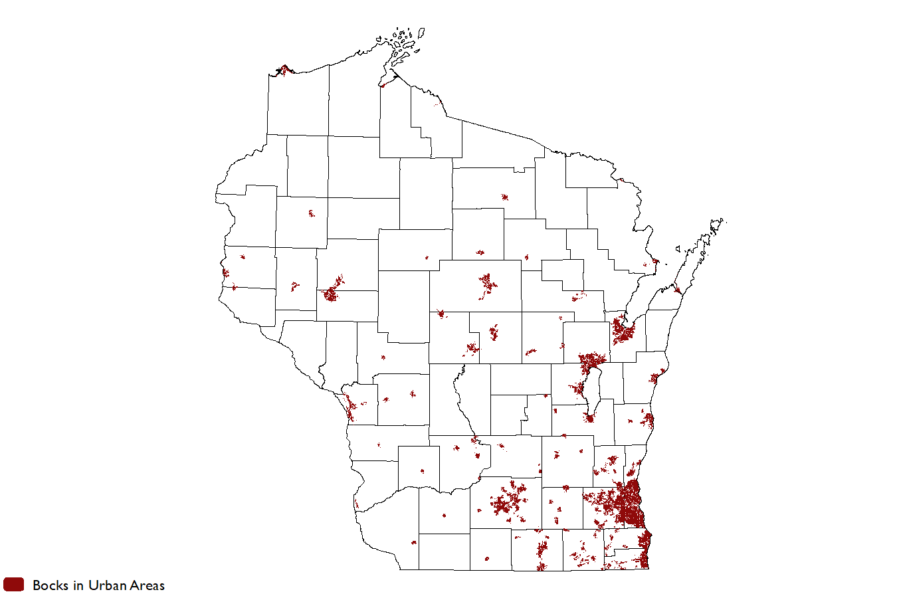
2020 Census Blocks in Urban Areas

Slide 4
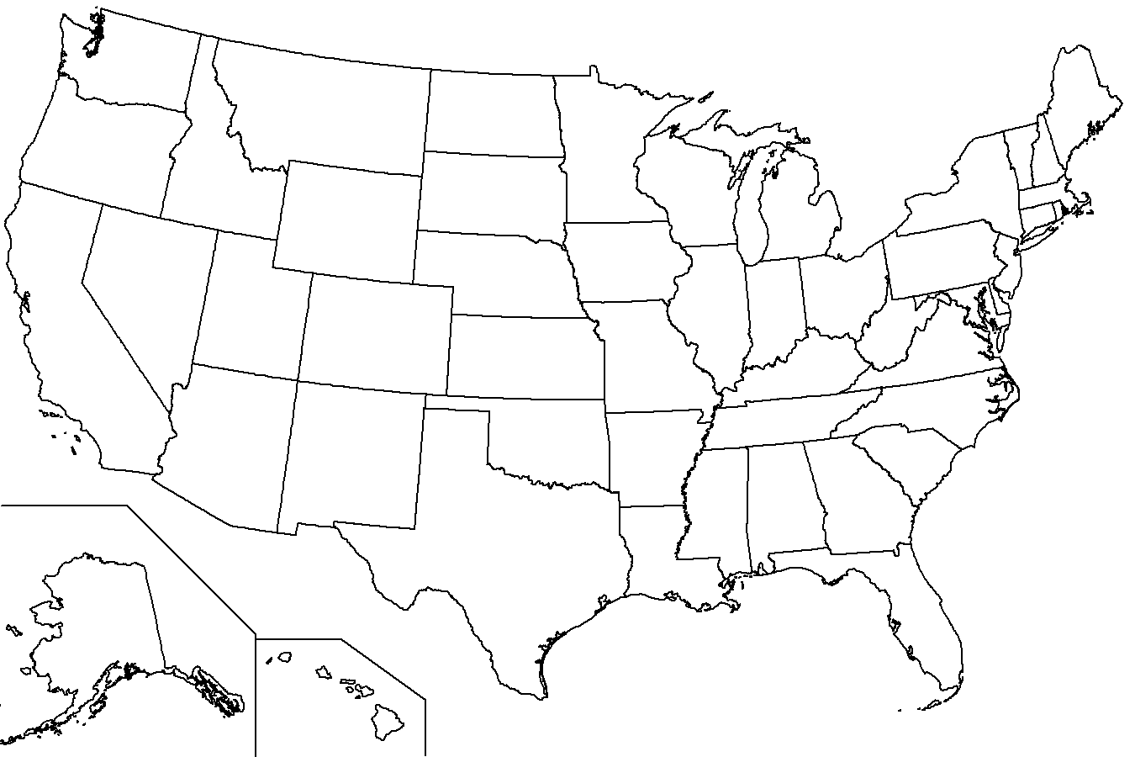
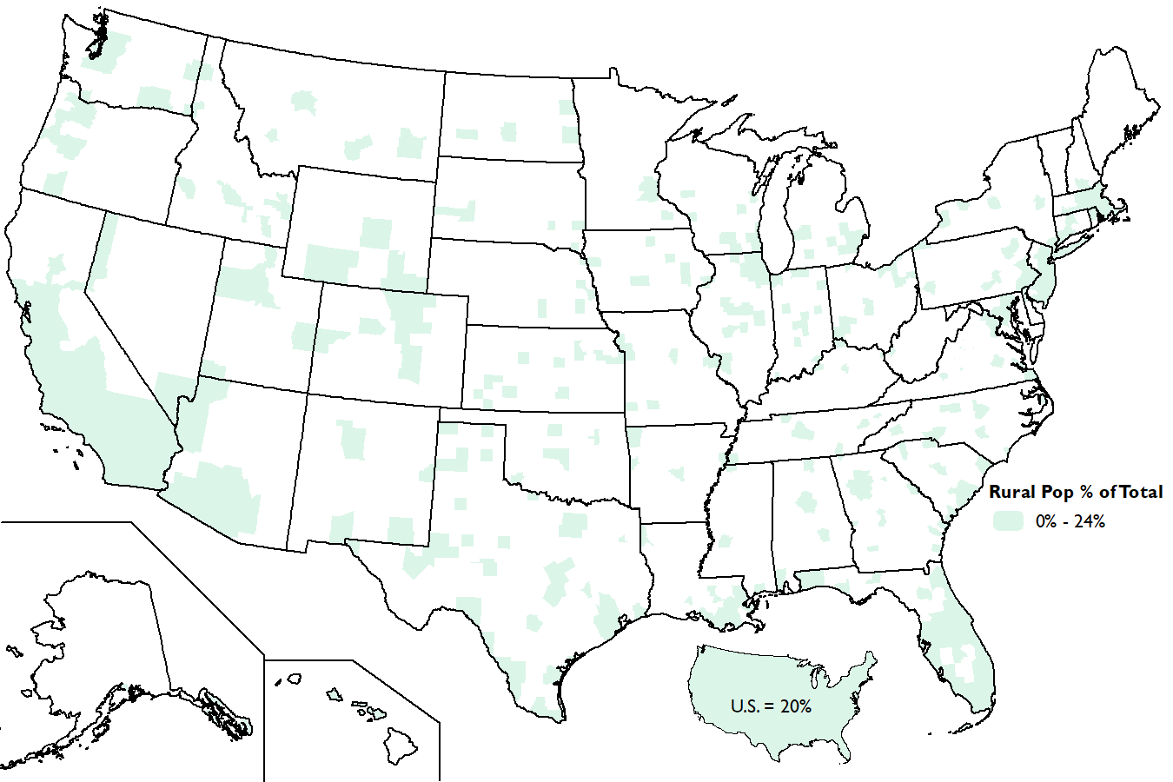
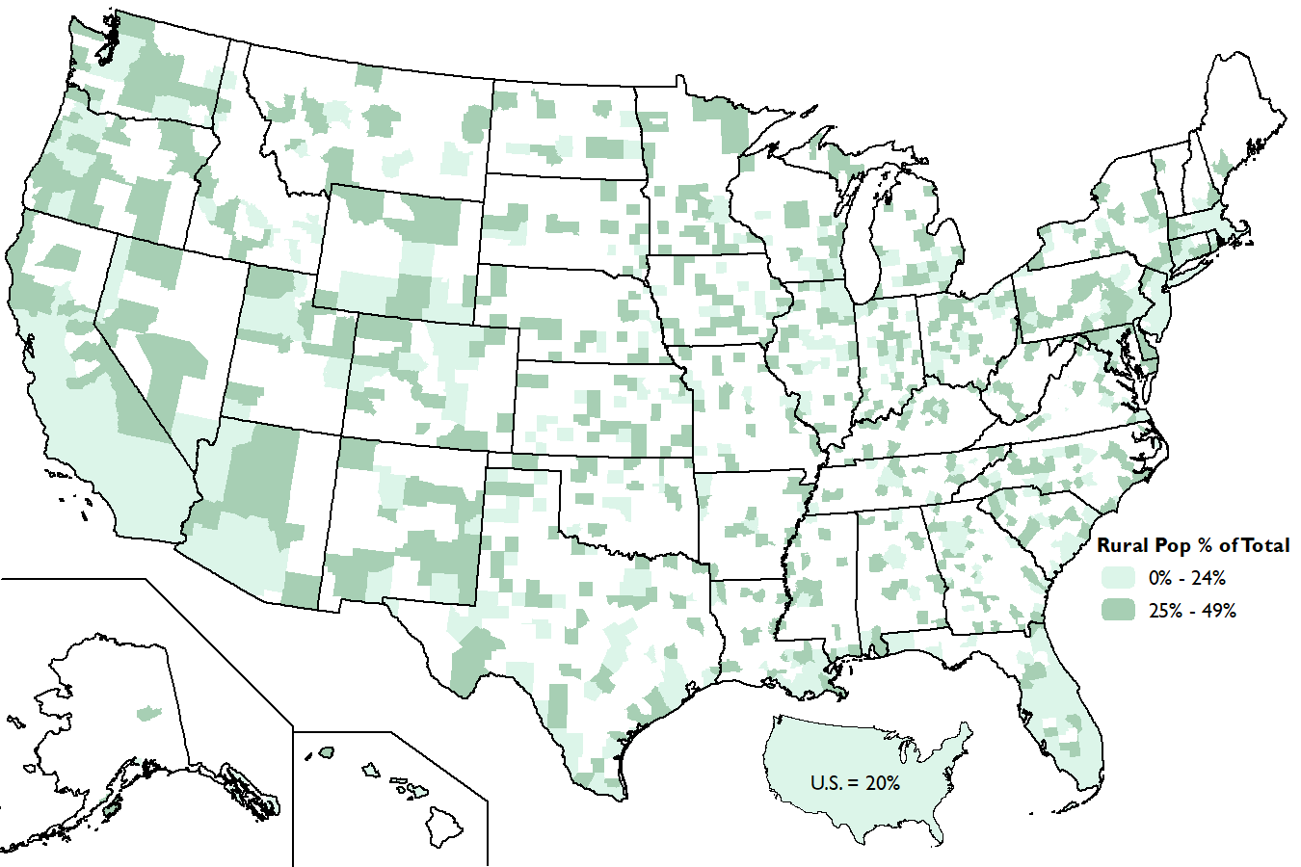
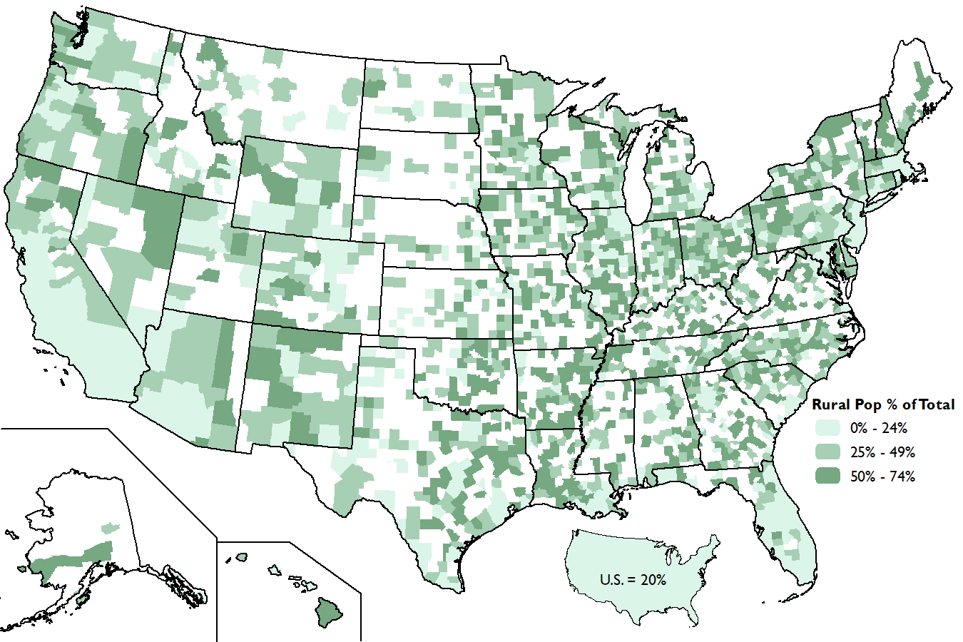
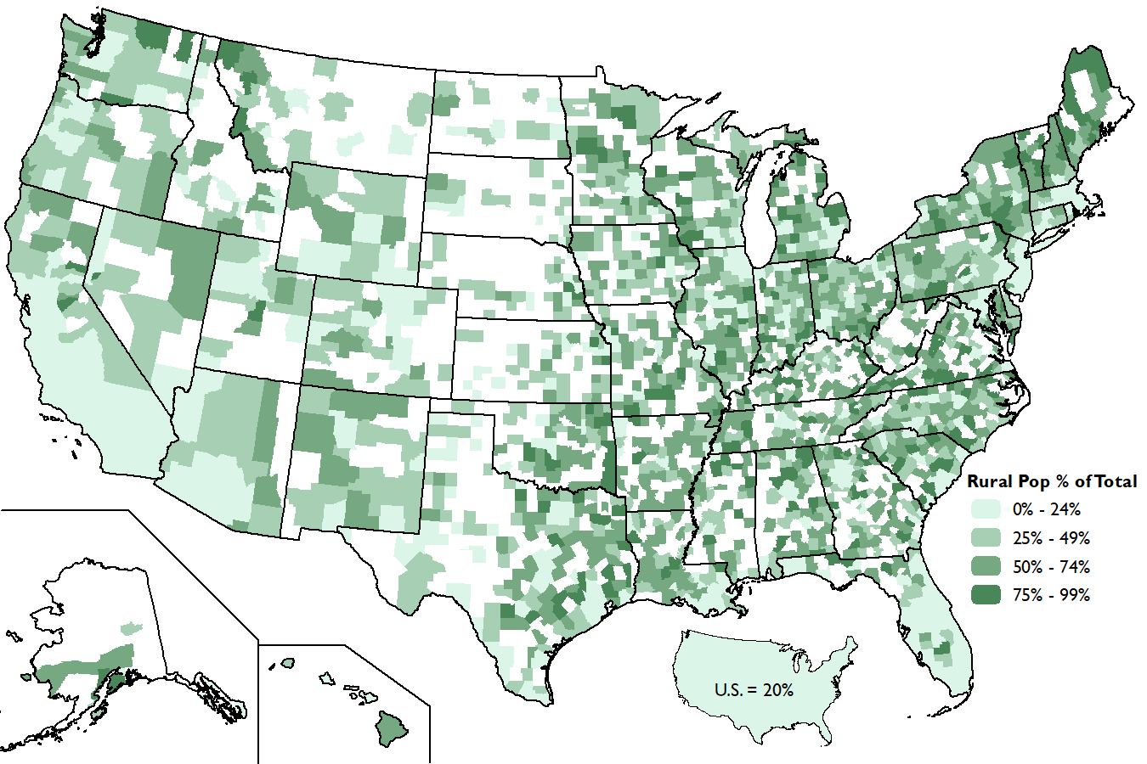
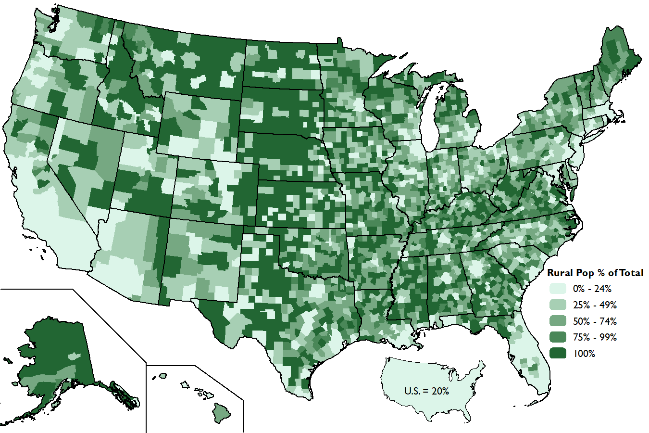
Rural Population as a Percent of Total Population
Source: 2020 Census Table P2, Urban and Rural https://data.census.gov/advanced

Slide 5
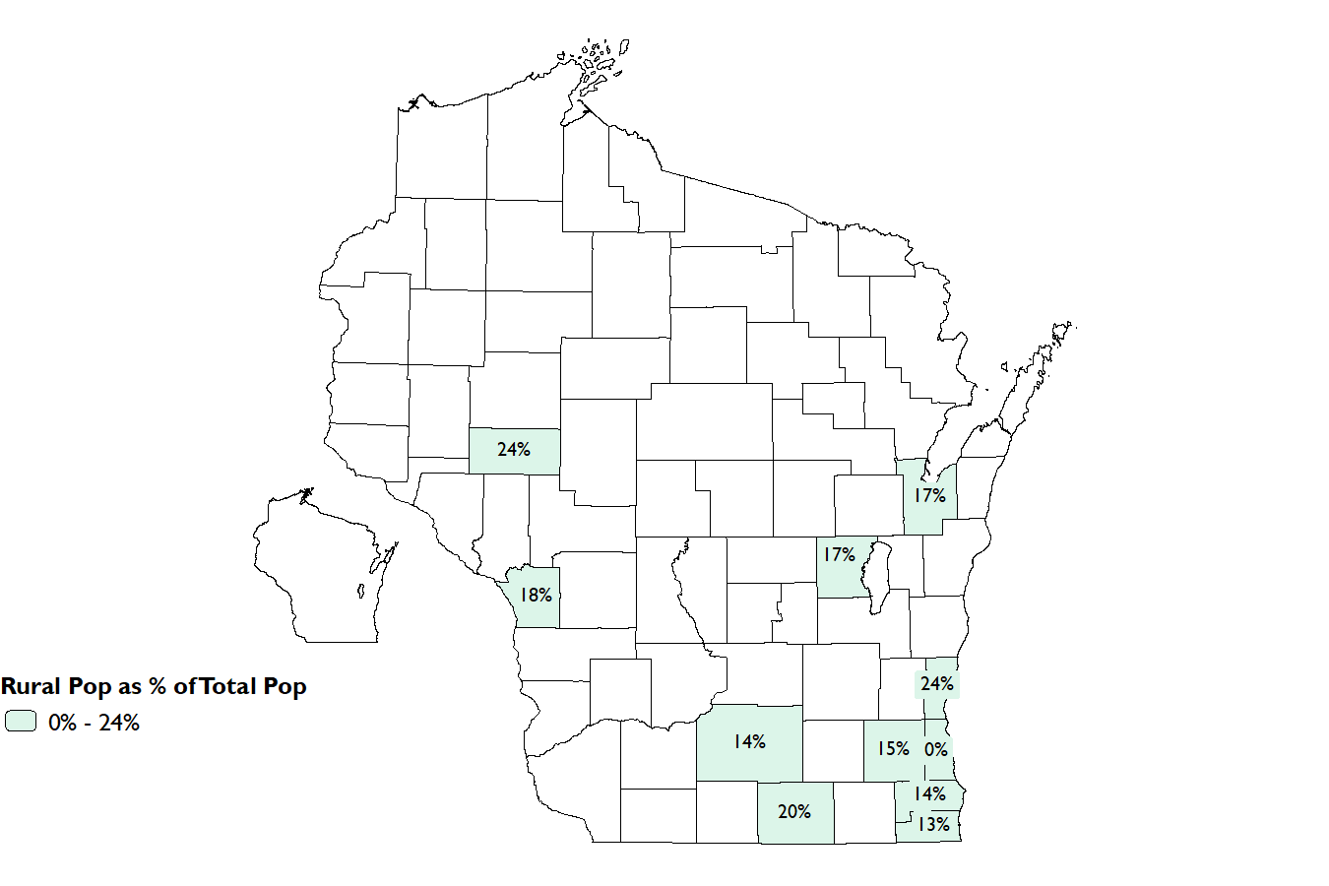
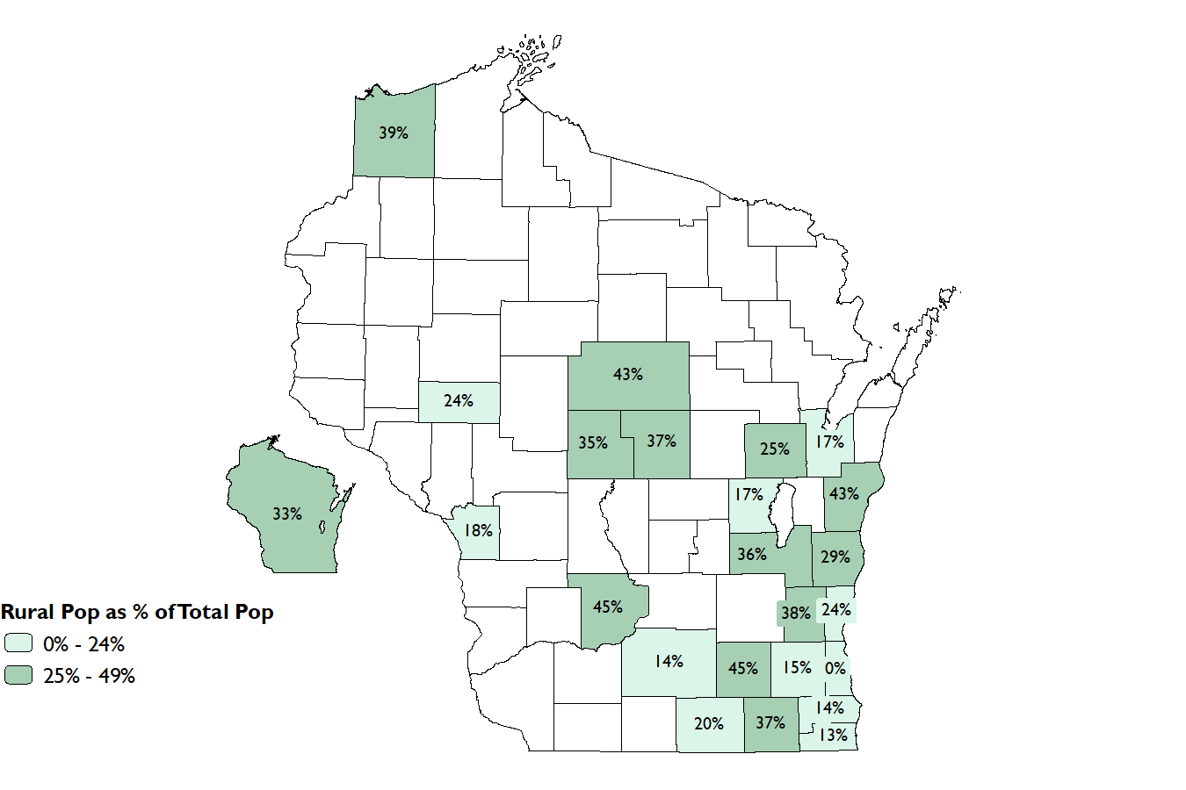
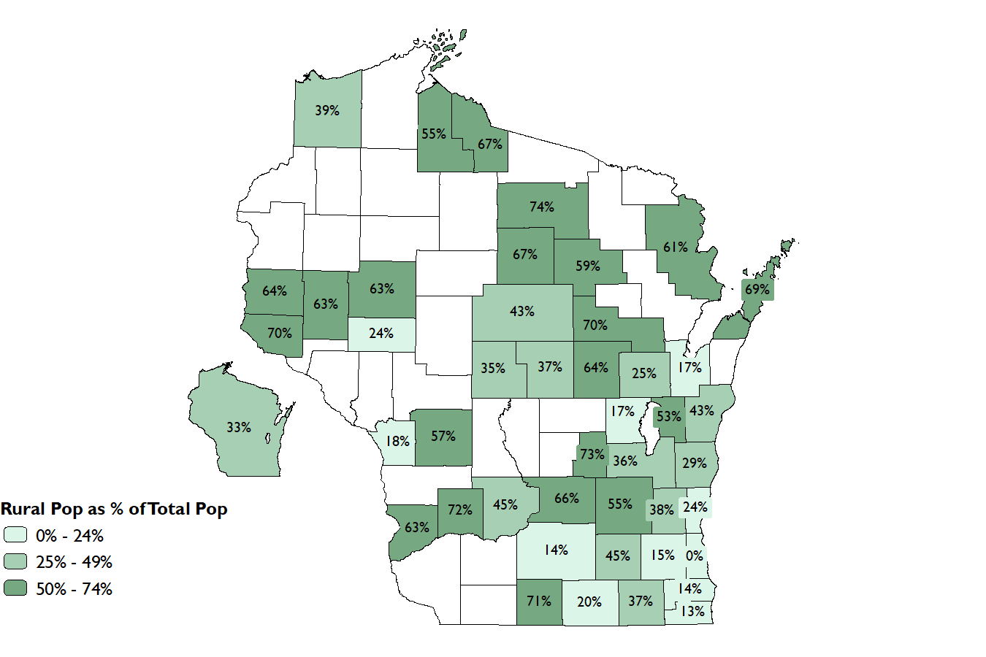
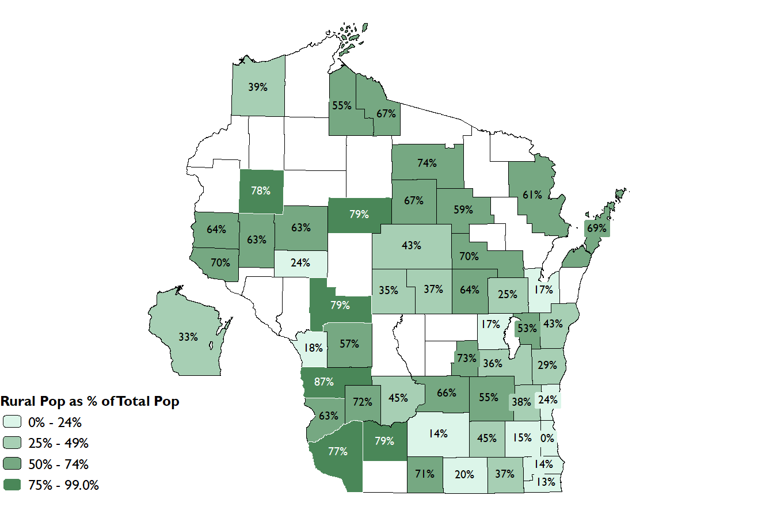
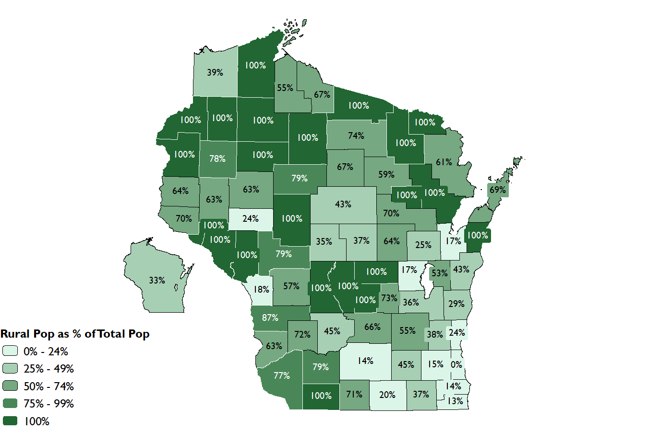
Rural Population as a Percent of Total Population
Source: 2020 Census Table P2, Urban and Rural https://data.census.gov/advanced

Slide 6
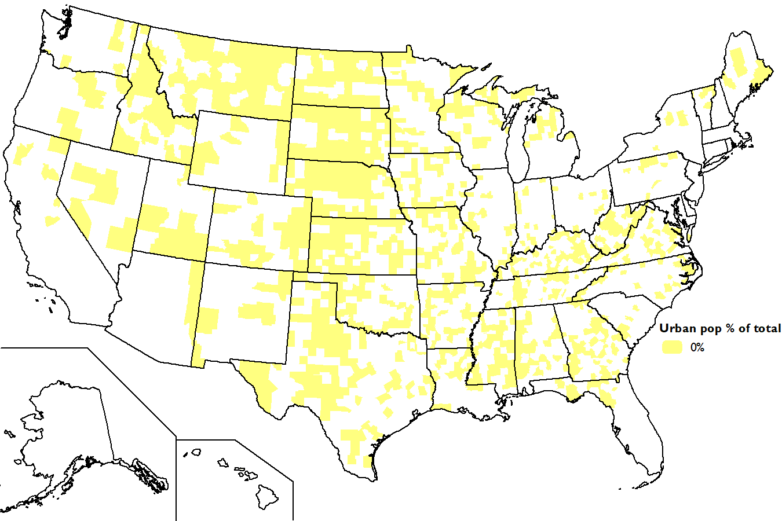
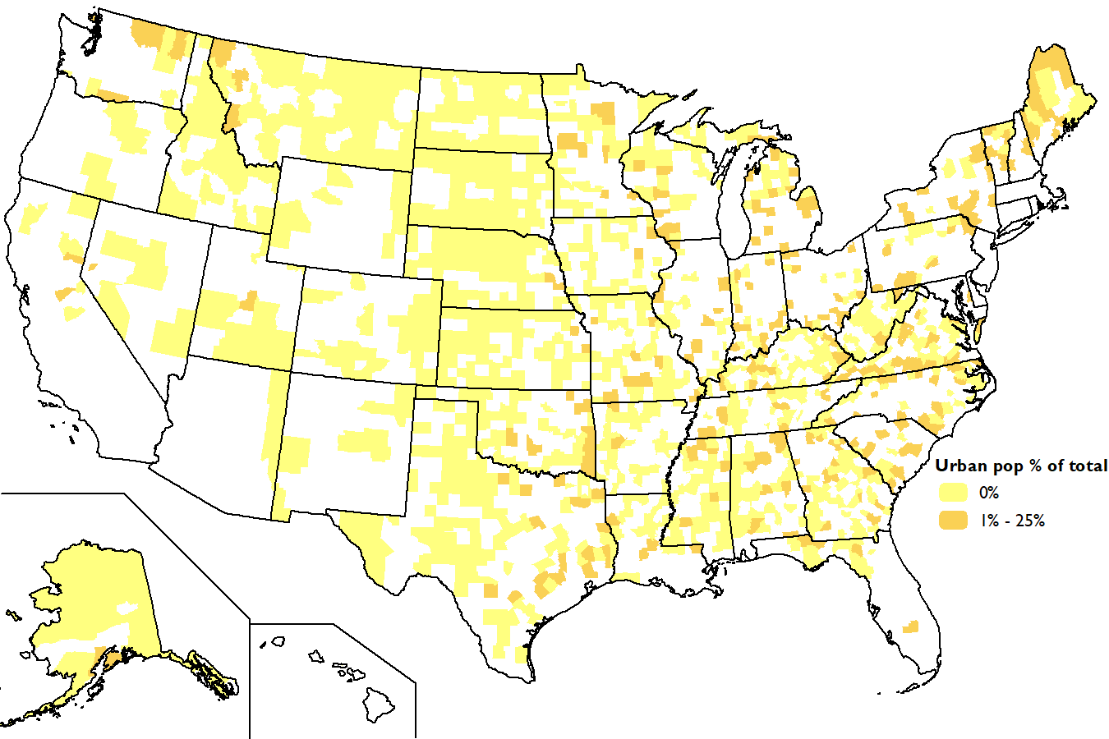
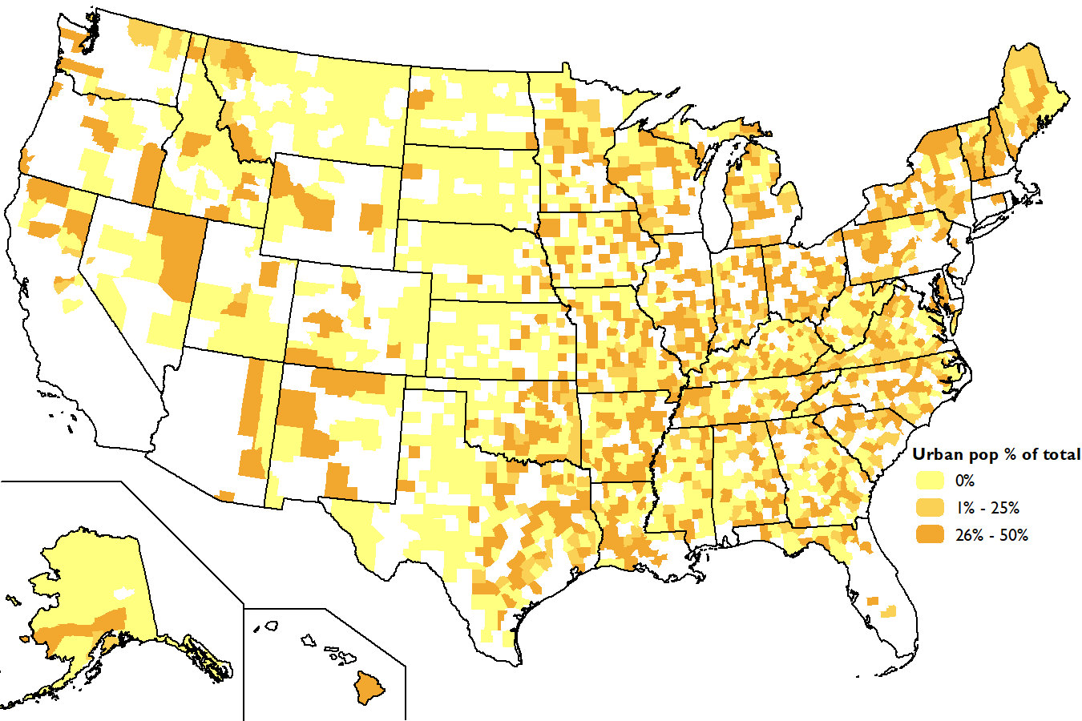
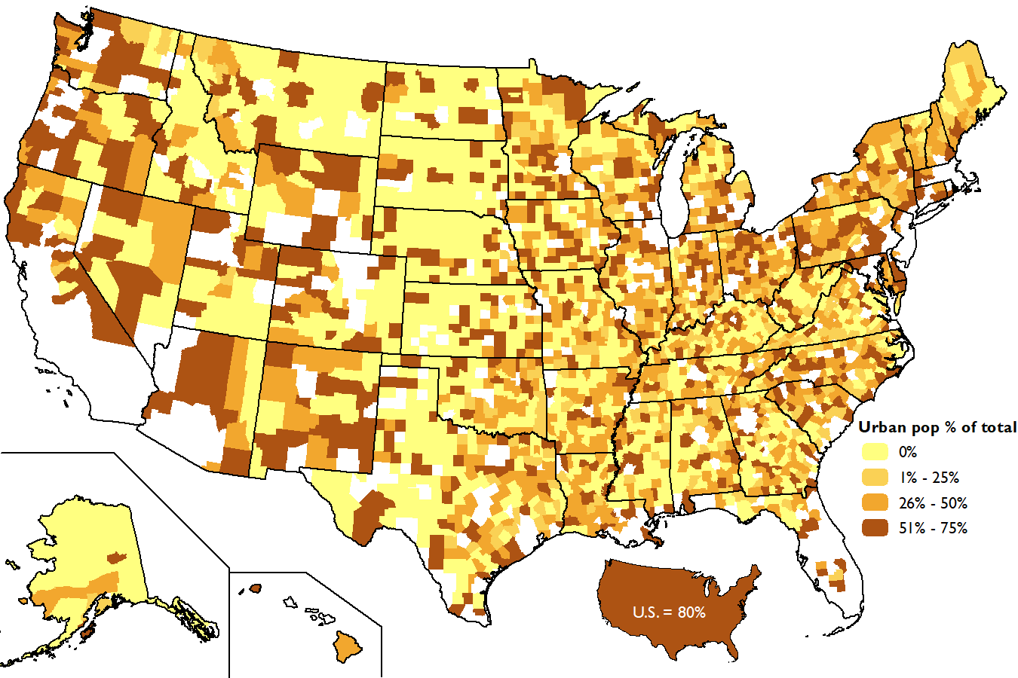
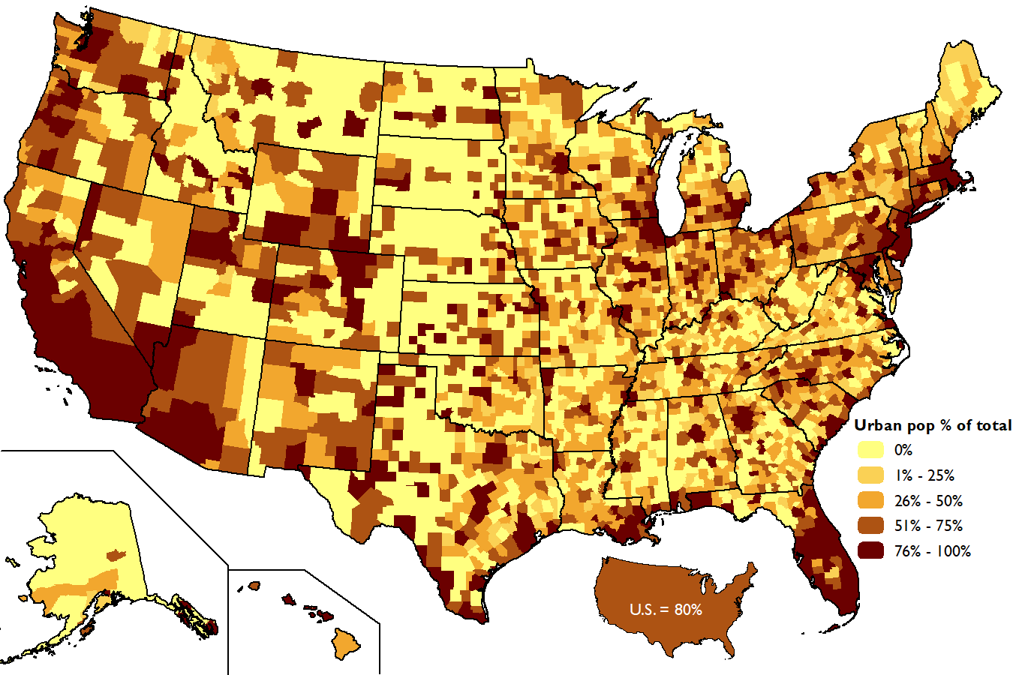
Urban Population as a Percent of Total Population
Source: 2020 Census Table P2, Urban and Rural https://data.census.gov/advanced

Slide 7
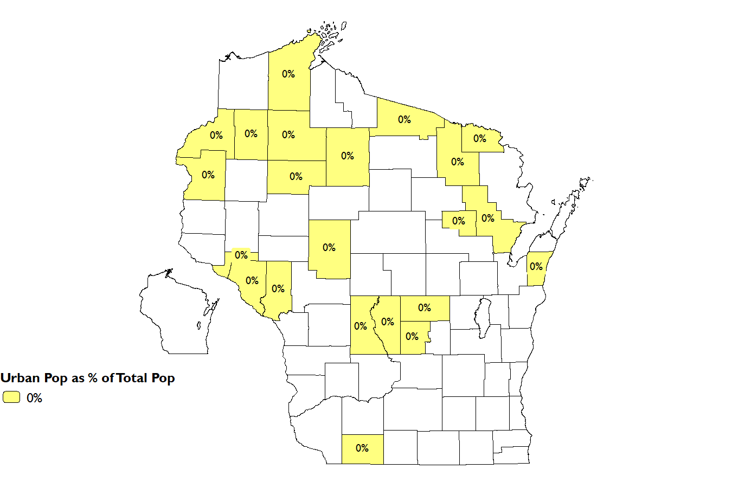
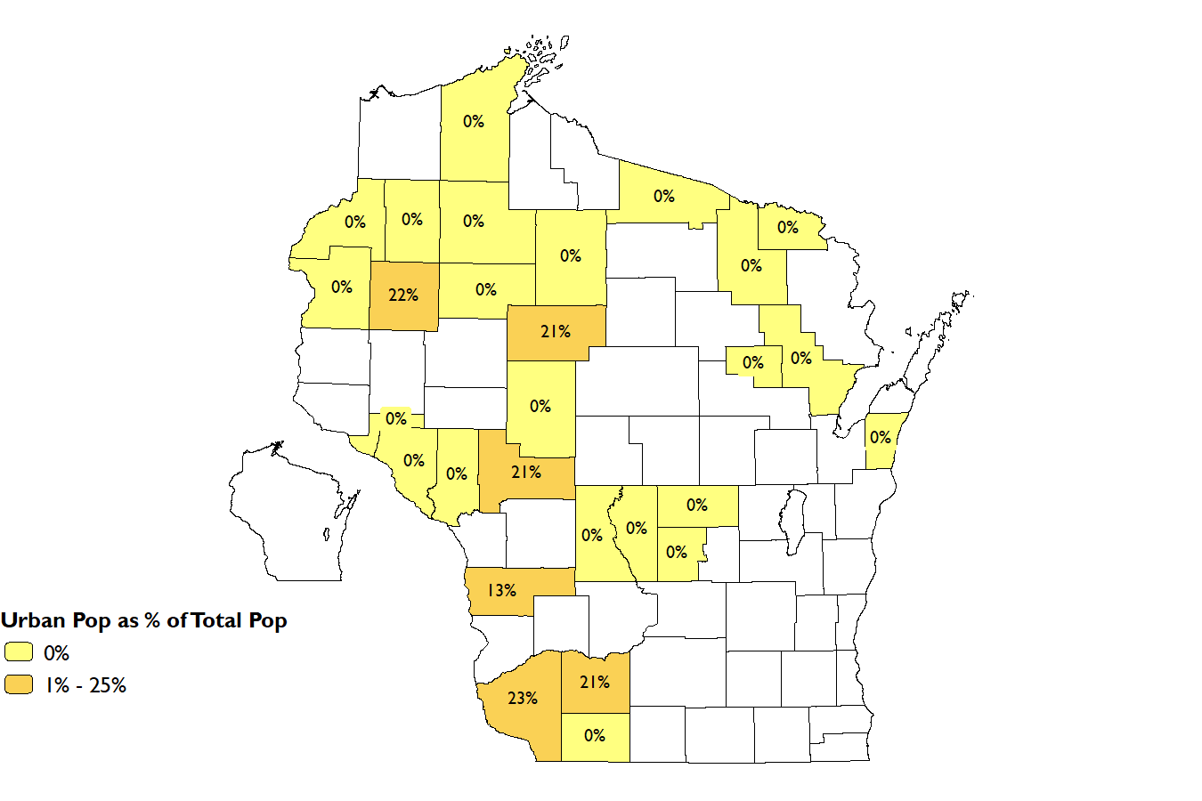
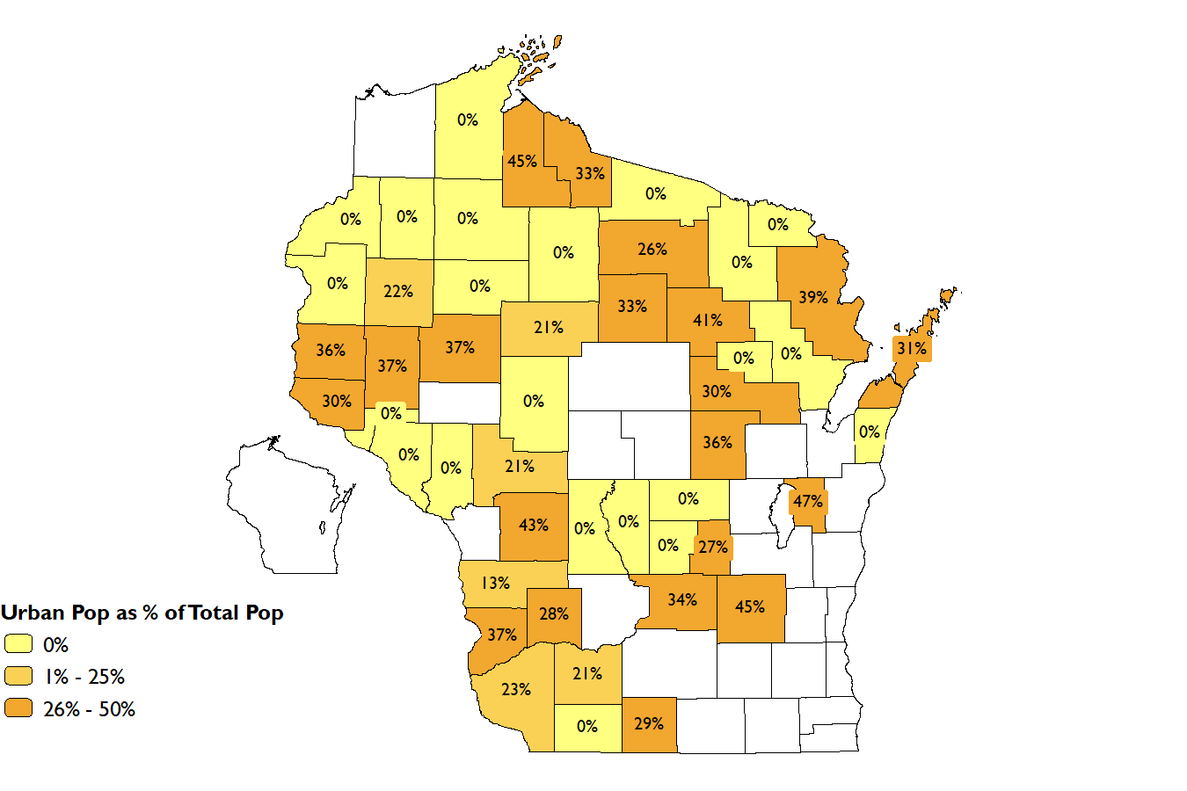
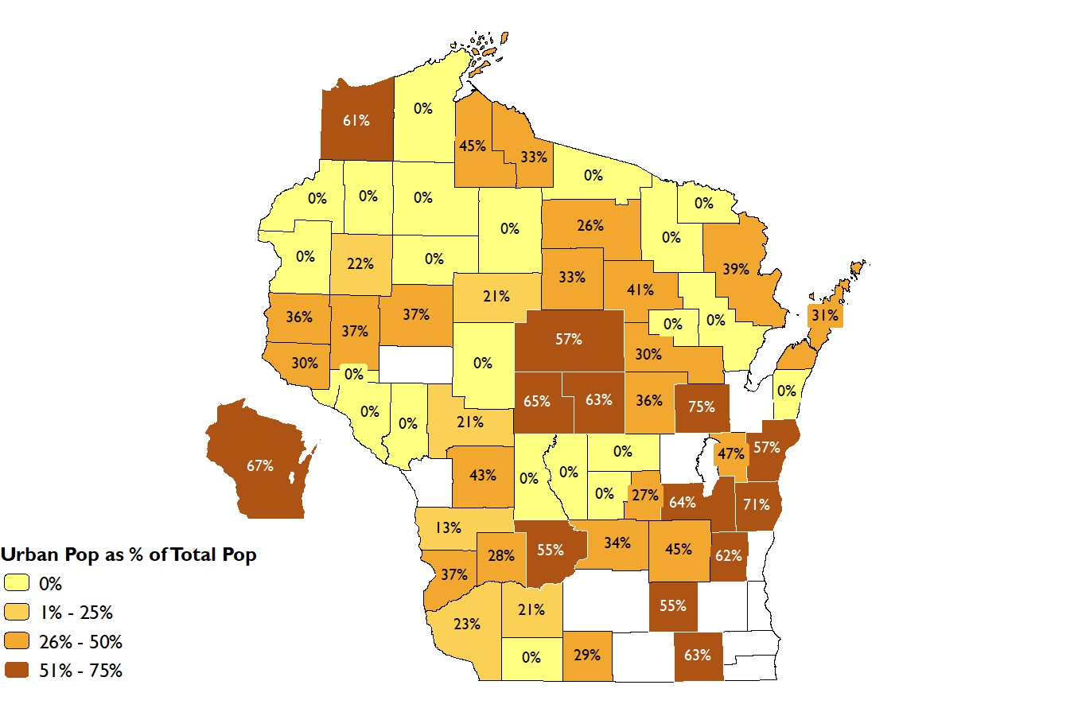
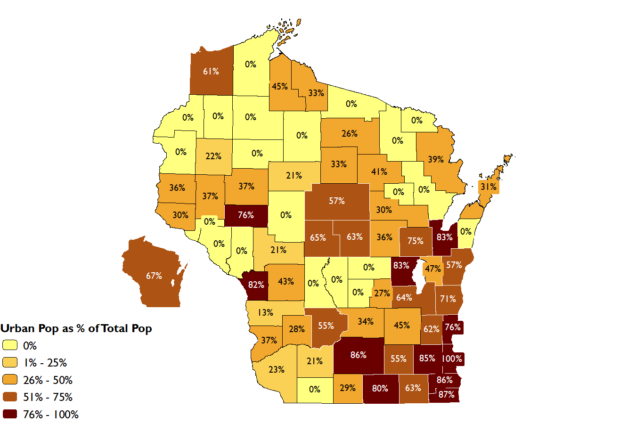
Urban Population as a Percent of Total Population
Source: 2020 Census Table P2, Urban and Rural https://data.census.gov/advanced

