Slide 1
2024 Population Projections
Overview and Visualizations
December 2024

Slide 2
Section 1: The Base We Build On
Fertility changes and age distributions

Slide 3
Total Fertility Rates
The Total Fertility Rate estimates how many children the average female would
have if females experience one year’s fertility patterns over their whole lives.
The 1960 Total Fertility Rate of 4.1 suggests that if females experienced 1960
fertility rates over the course of their lives, the average female would have 4.1
children.
Total Fertility Rates around 2.04-2.09 typically suggest the population would be
relatively stable. If Total Fertility Rates are higher, this suggests that each
generation will be larger than the one before. If Total Fertility rates are lower,
this suggests that each generation will be smaller.
Changes in life expectancy or migration affect population dynamics.

Slide 4
Total Fertility Rates
From 1950 through 1970, Total Fertility Rates
well above 2.1 suggested that each generation
might be larger than the one before.

Slide 5
Total Fertility Rates
From 1975 through 2020, Total Fertility Rates
often below 2.1 suggested that each generation
might be smaller than the one before.

Slide 6
WI Population (in thousands)
In 2010, many baby boomers were in two age
groups: 45-49 and 50-54. In the age distri-
bution, call this a “population bump”.

Slide 7
WI Population (in thousands)
By 2030, the bump moves rightward,
to ages 65-69 and 70-74, entering
age groups with more retirees.

Slide 8
WI Population (in thousands)
By 2050, what remains
of the bump is in the
“85-and-over” age group.

Slide 9
Section 2: Projected Population
The age and fertility trends’ implications

Slide 10
WI Population (in thousands)
Wisconsin’s projected population does not dip below
2010 levels, but stable population and slight decreases
are more likely than increases.

Slide 11
Factors affecting county projections
County age distributions can differ considerably. High concentrations of 65-
and-over population may be correlated with lower fertility or higher mortality.
Age-Specific Fertility Rates are the number of births to females in an age group
per 1,000 females in the group. Females aged 25-29 will not have the same
Age-Specific Fertility Rate in every county.
County population projections allow Age-Specific Fertility Rates to change
over time rather than remain static. (For example, many counties have
experienced decreases in Age-Specific Fertility Rates for ages 15-19. These
decreases are trended forward.

Slide 12
2020 Age Distribution (percent of total population)
In 2020, age groups between 15 and 44 were
35% of Trempealeau County population
and 24% of Florence County population.
This influences expected birth numbers.
In 2020, age groups 60-and-over were
25% of Trempealeau County population
and 41% of Florence County population.
This influences other population dynamics.

Slide 13
Age-Specific Fertility Rates
Counties’ Age-Specific Fertility Rates
differ markedly. This influences the
expected number of births.
Suppose a county expects higher birth
numbers (relative to its population).
This can increase the number of younger
residents, and affect age distribution.

Slide 14
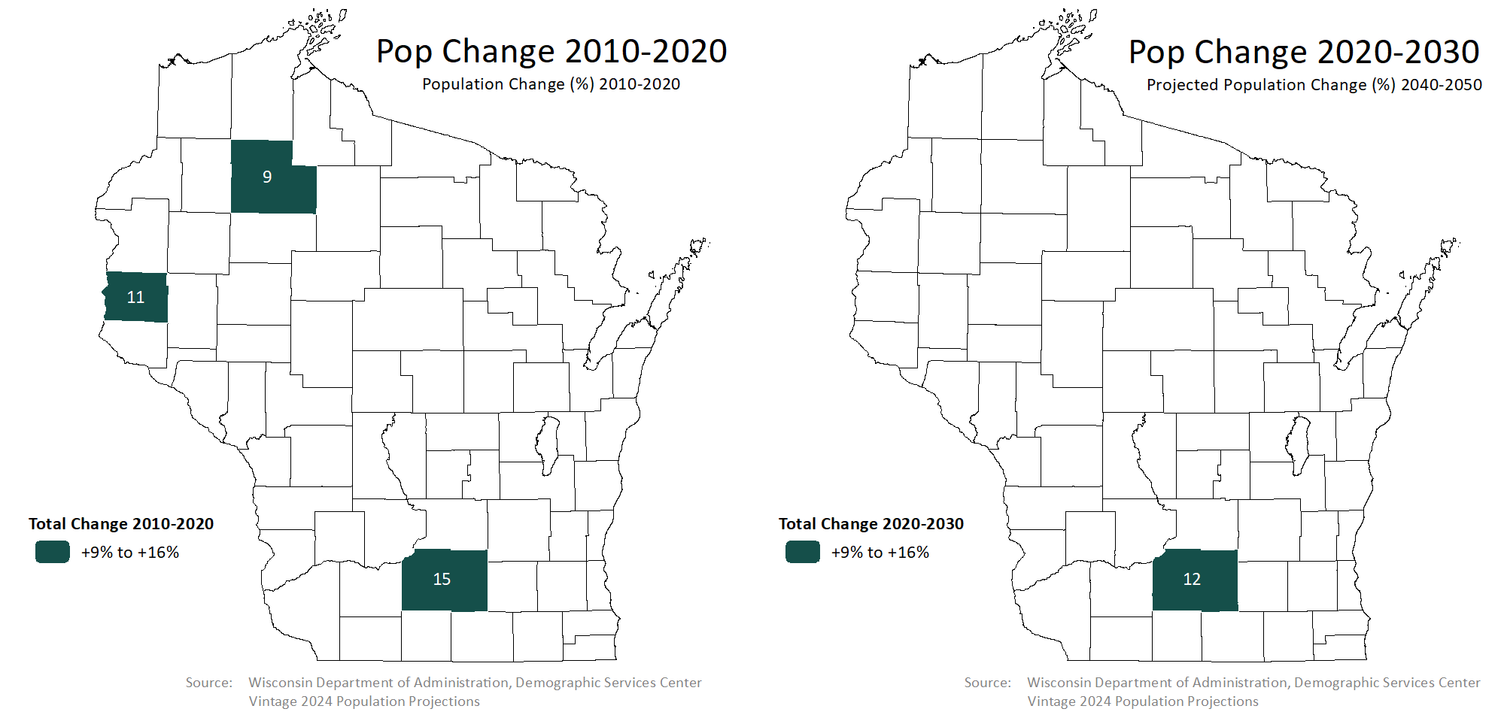
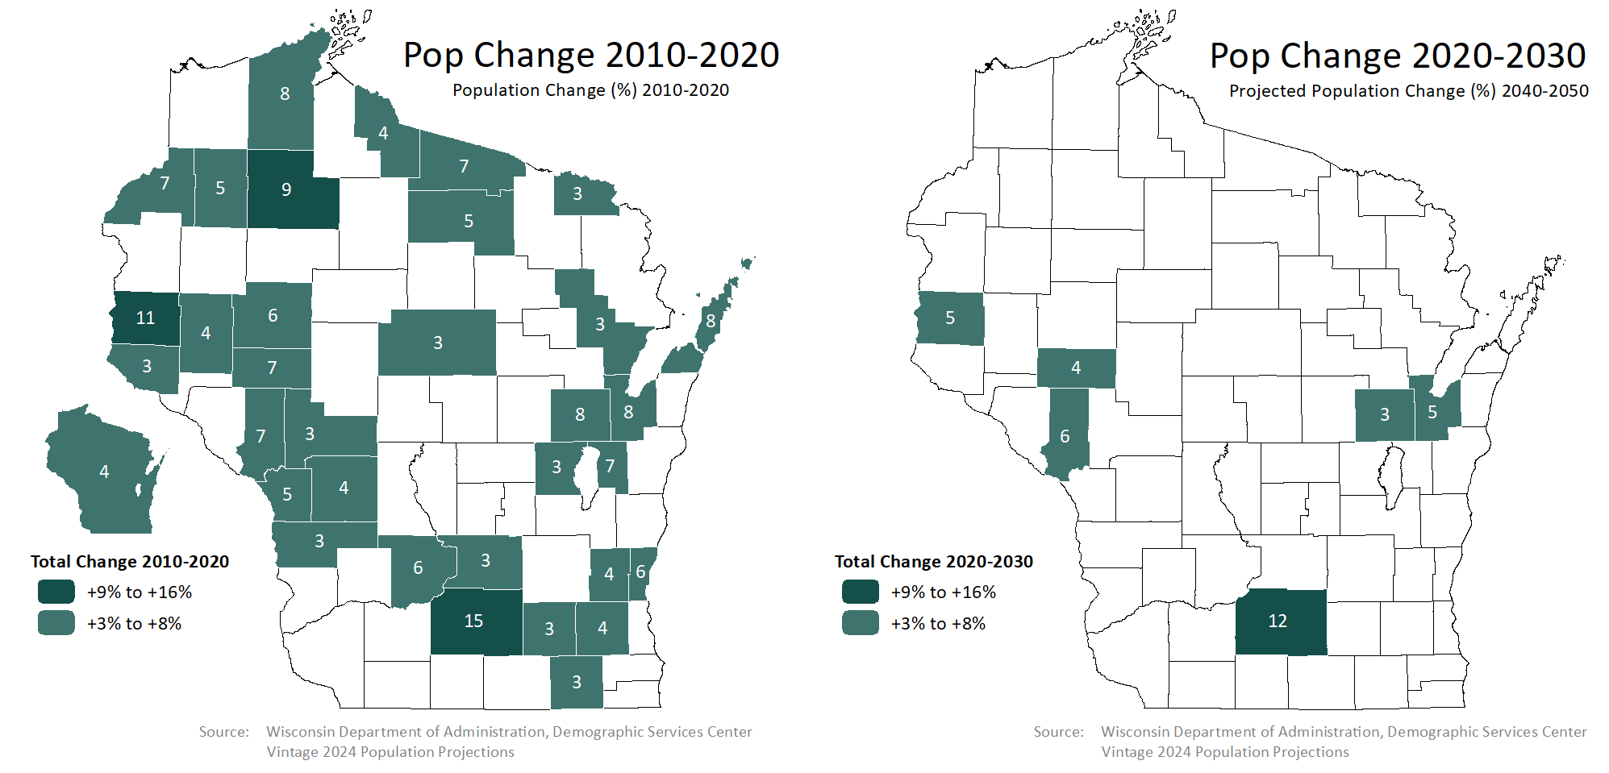
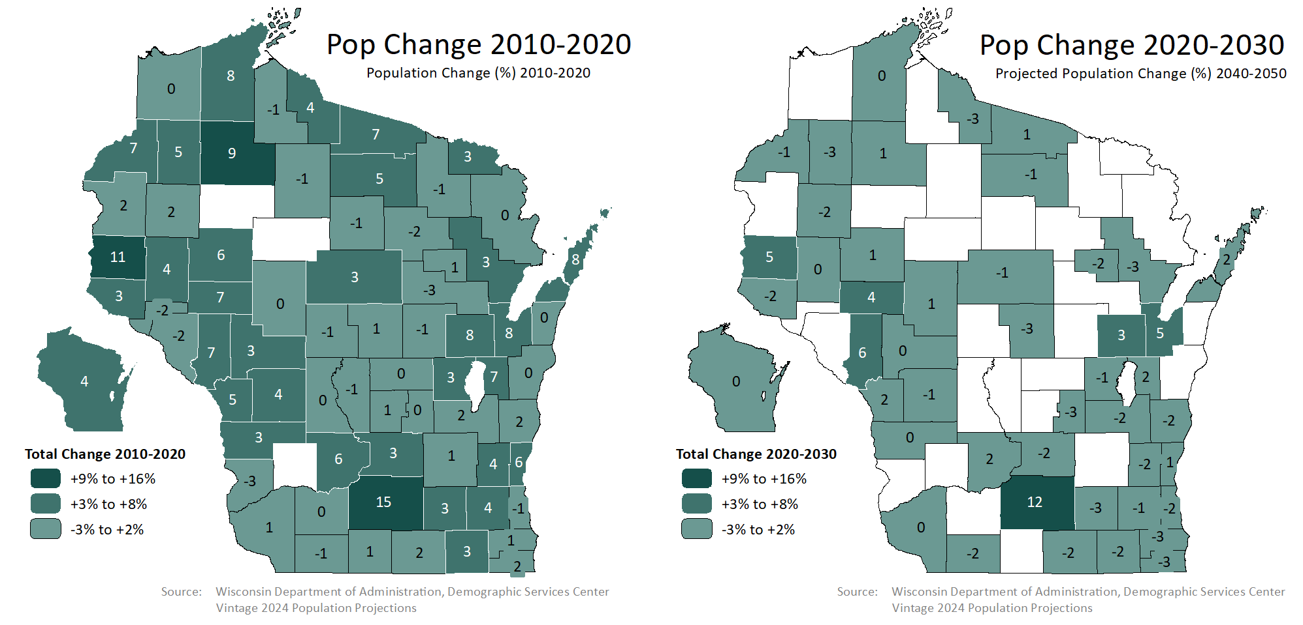
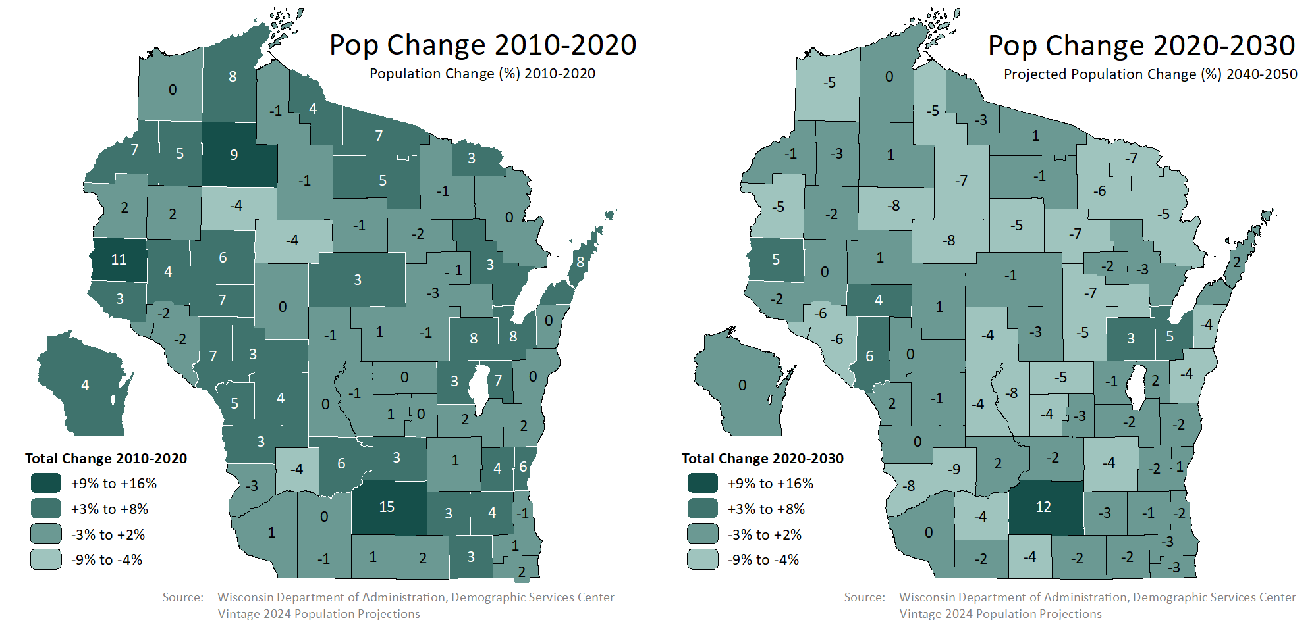

Slide 15
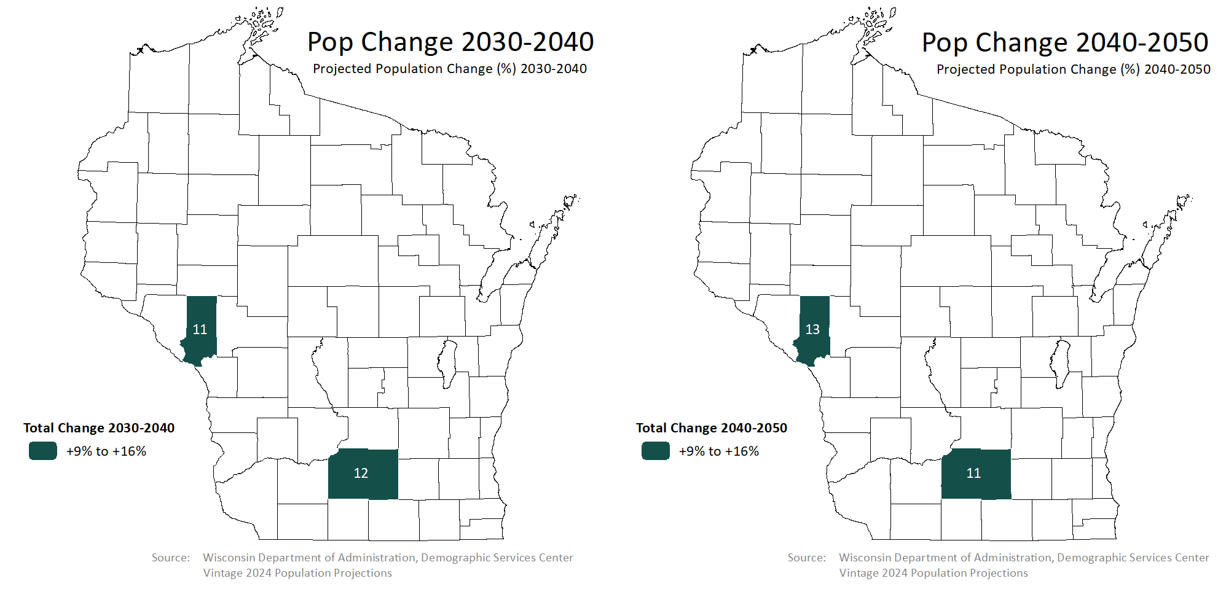
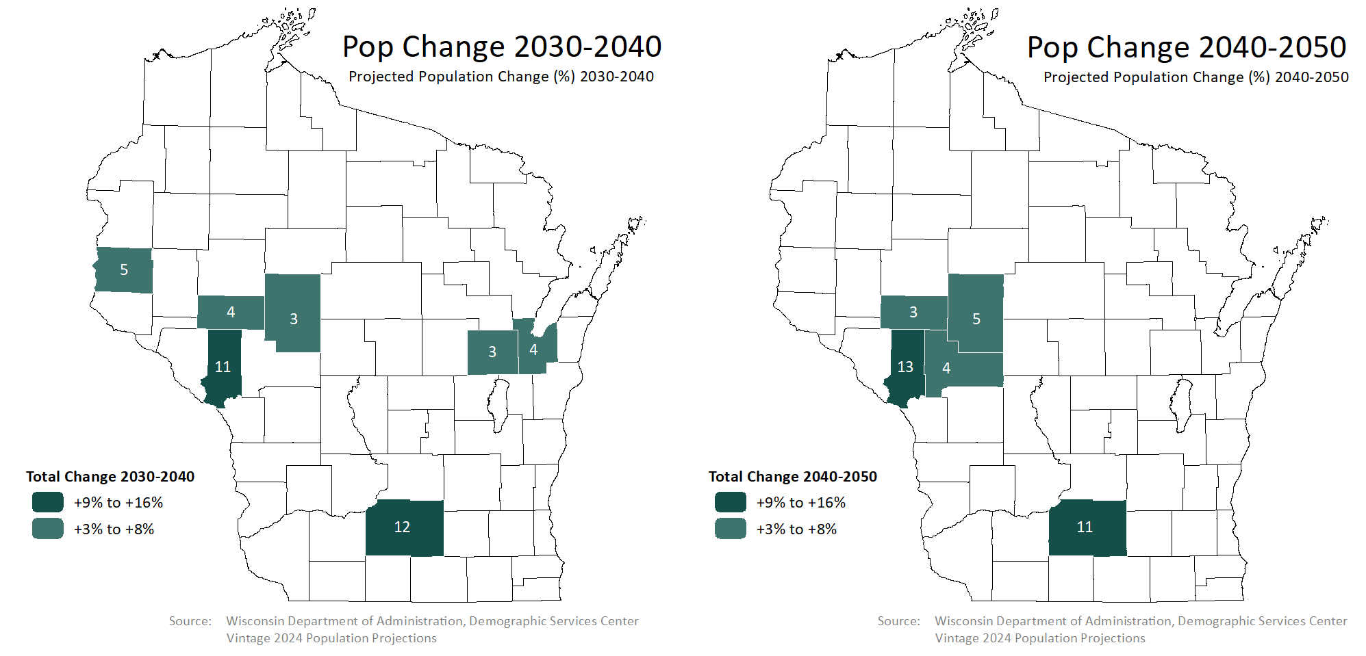
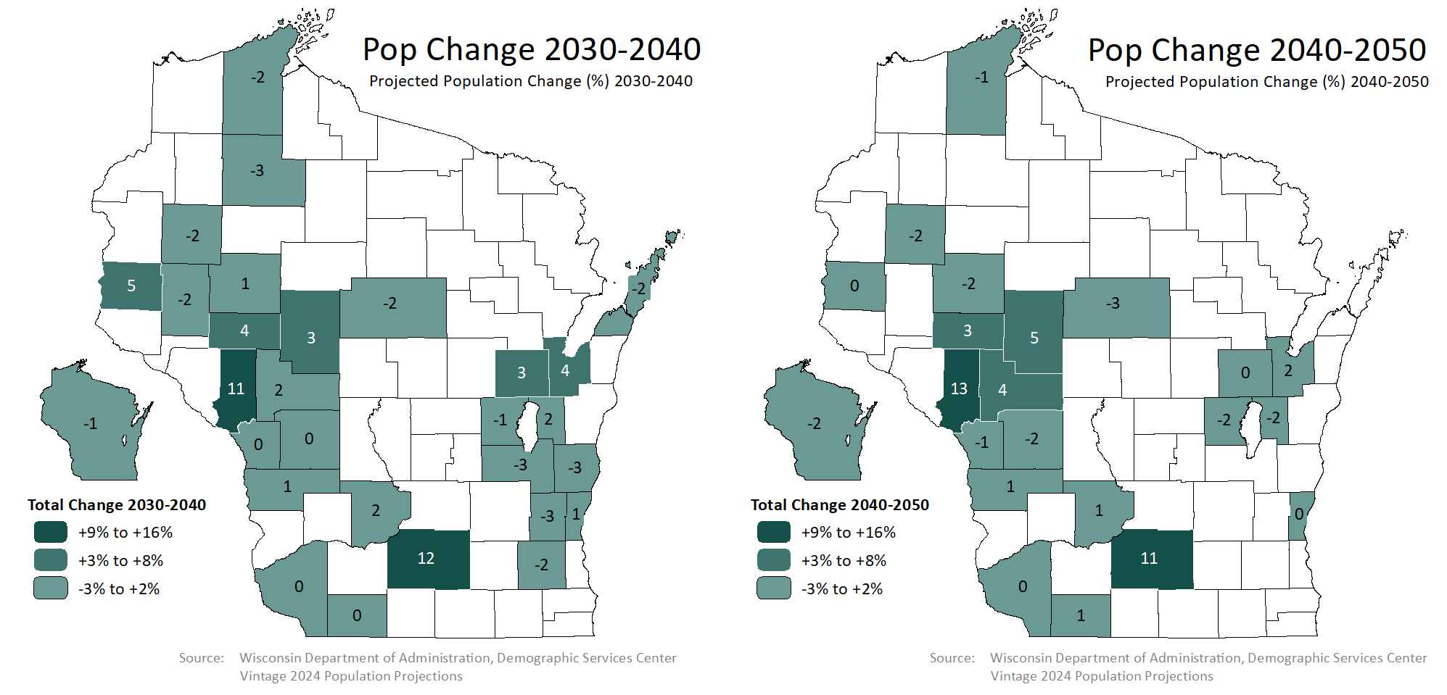
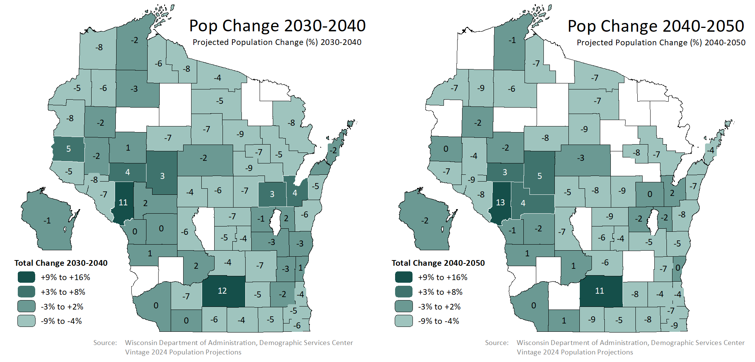
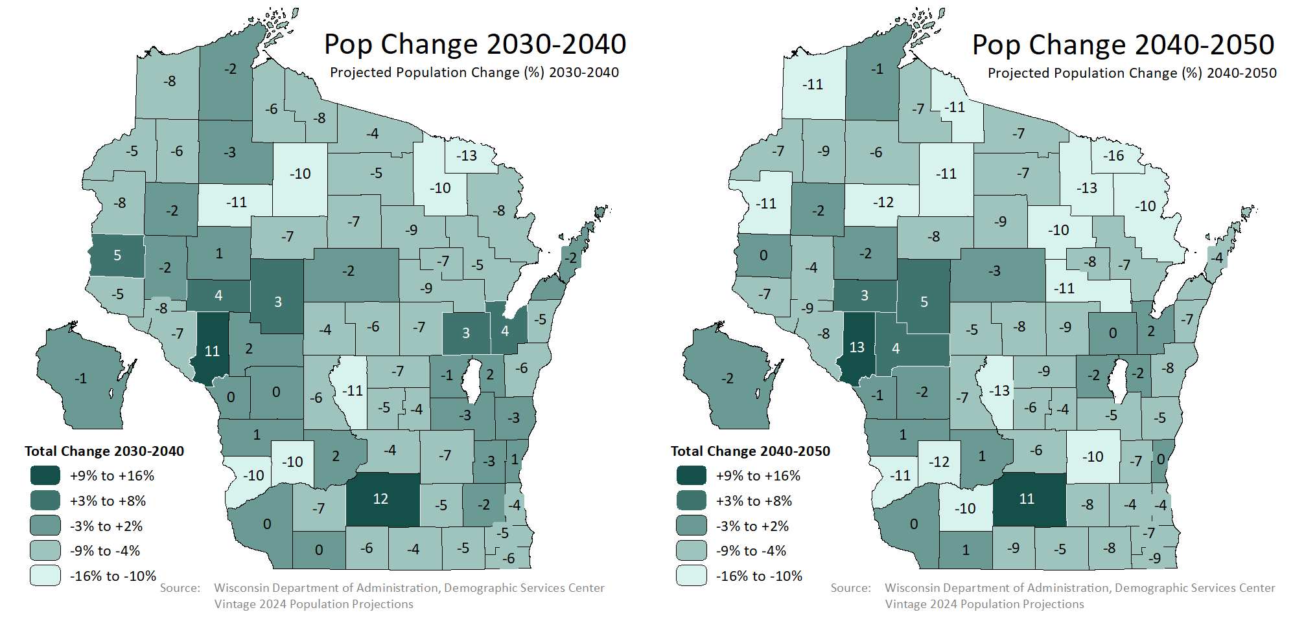

Slide 16
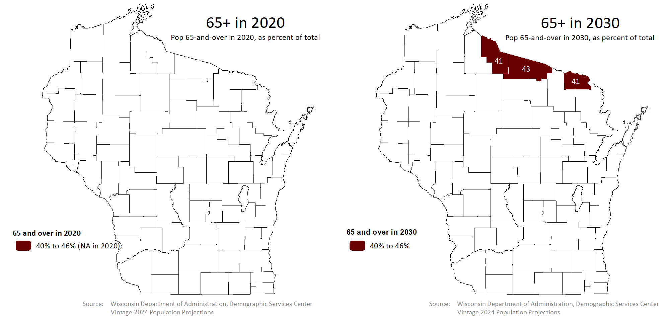
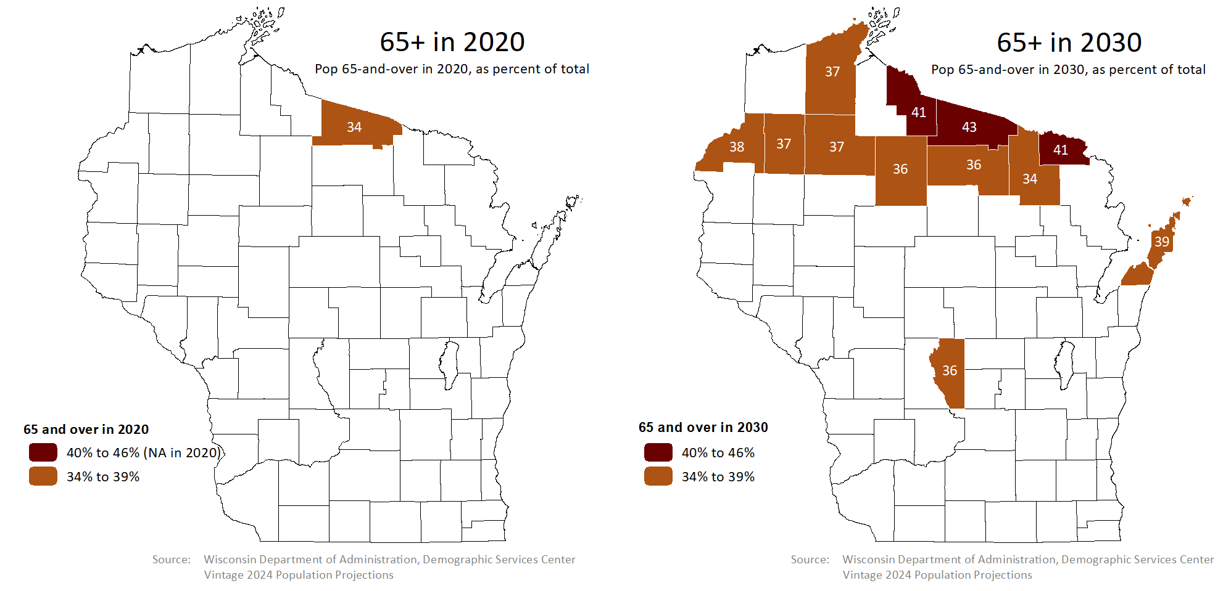
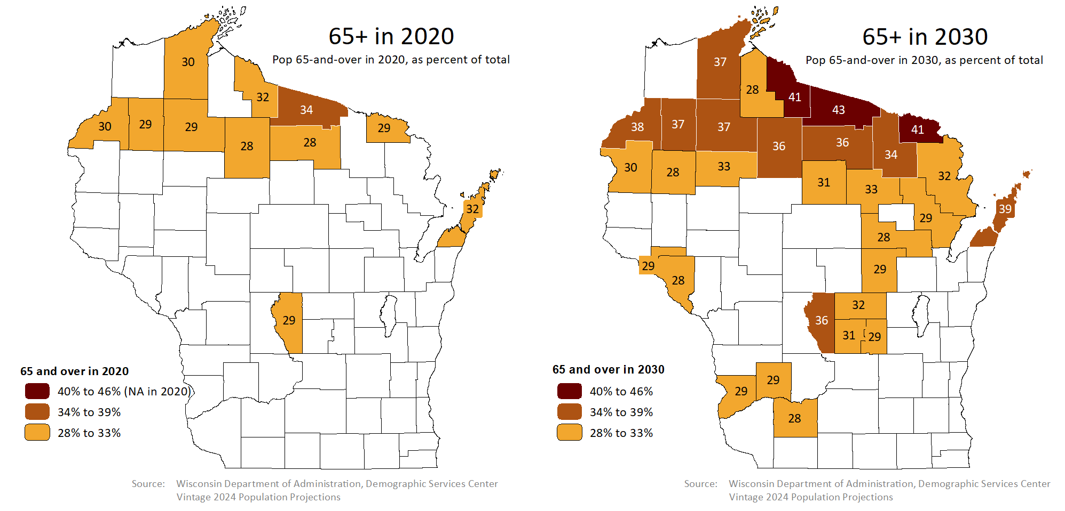
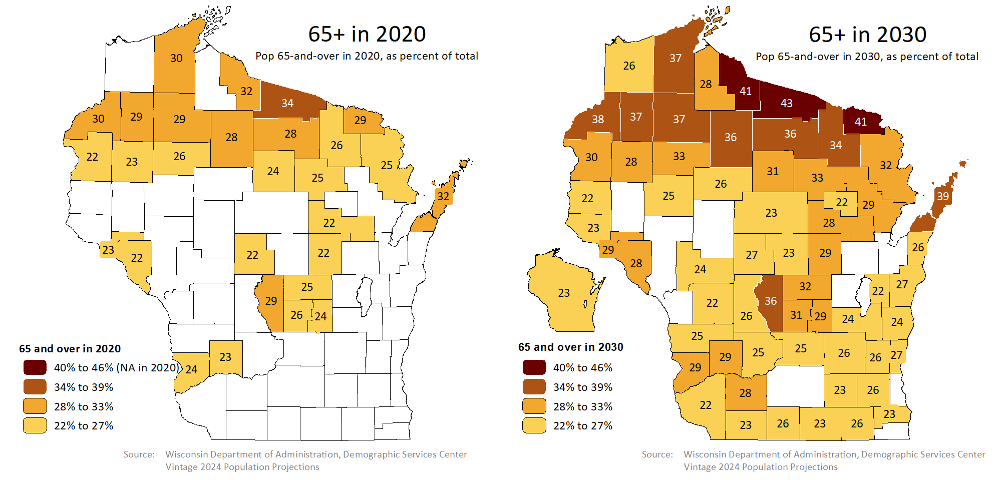
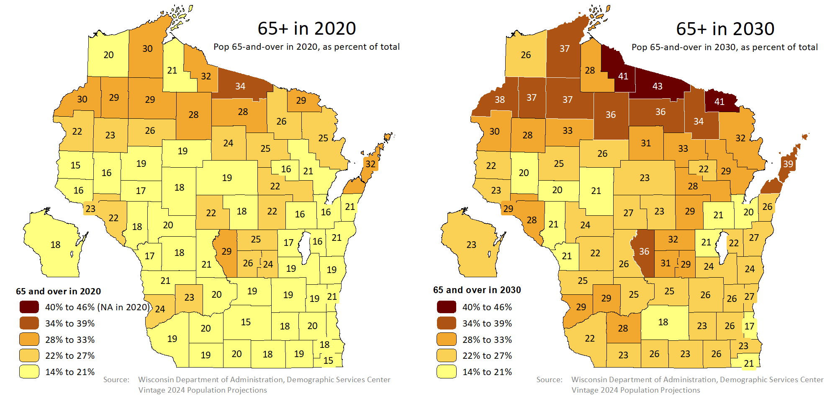

Slide 17
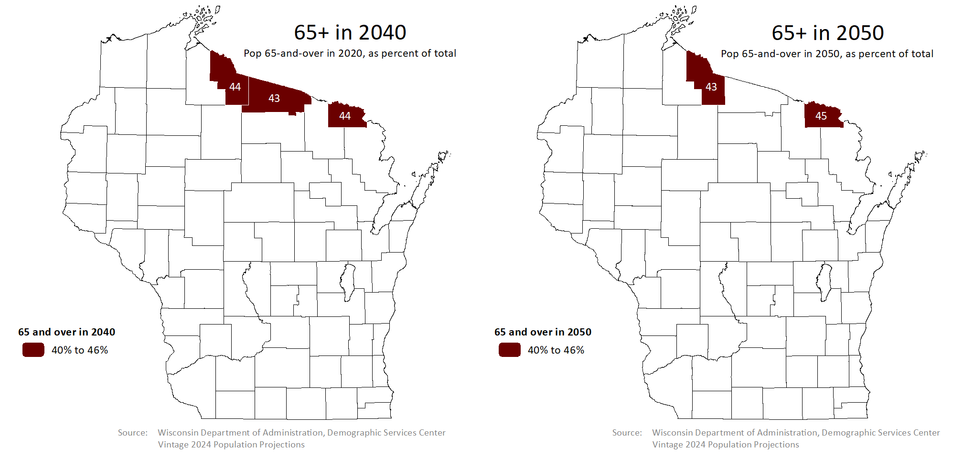
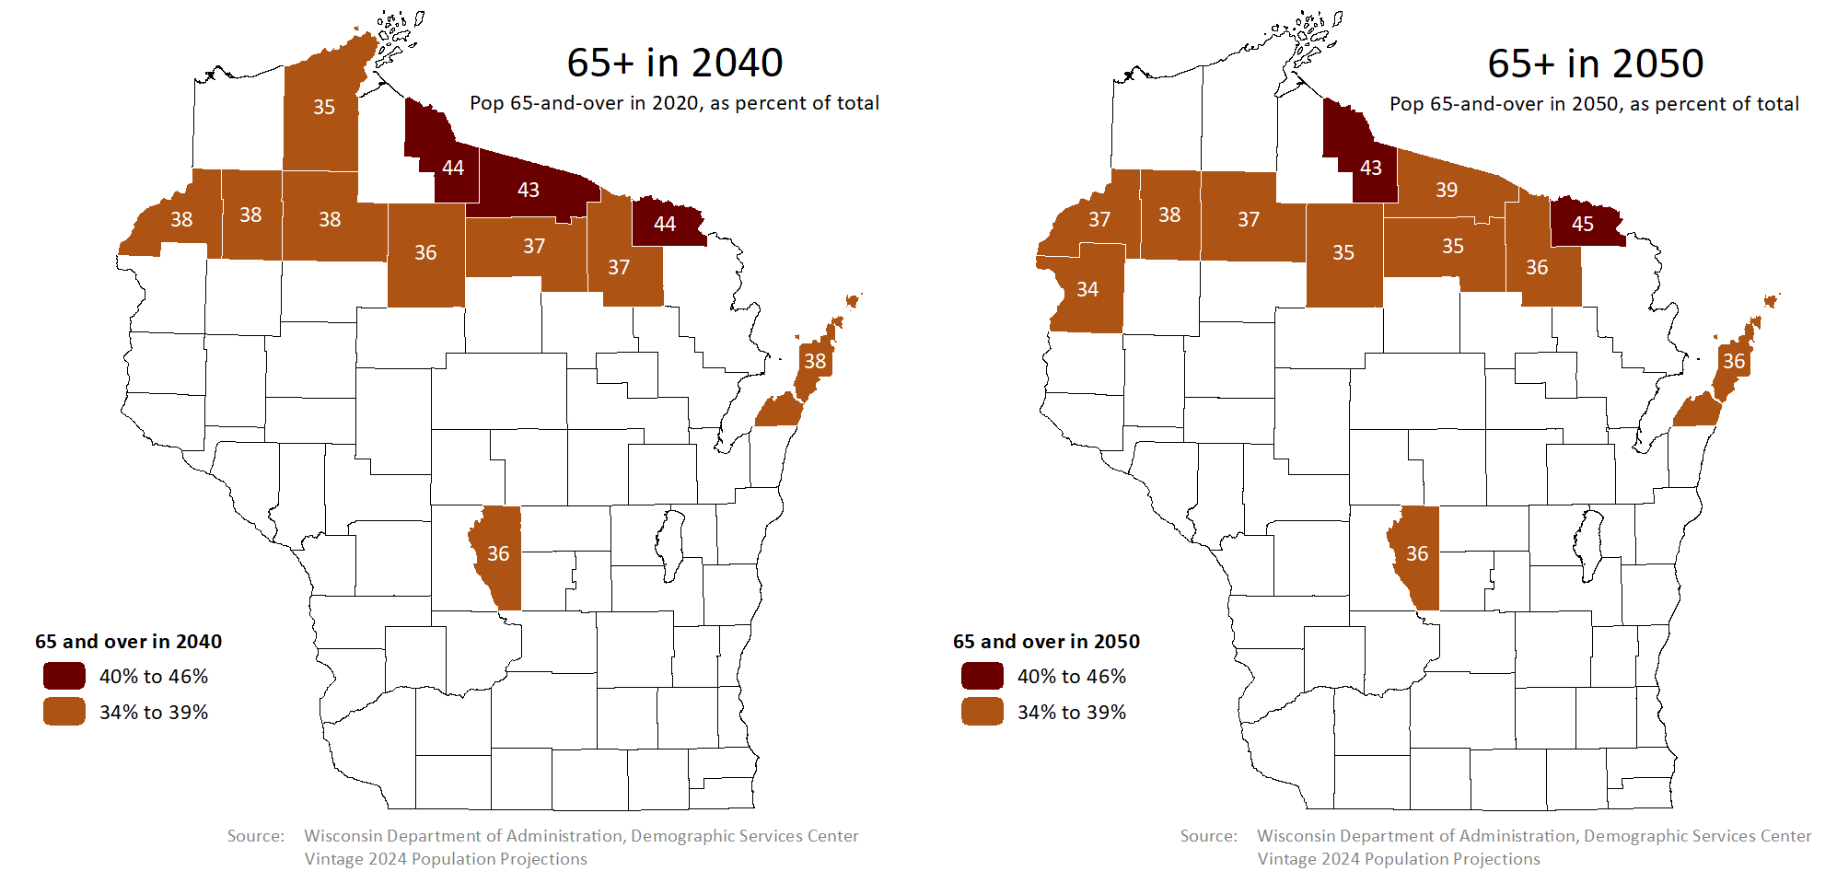
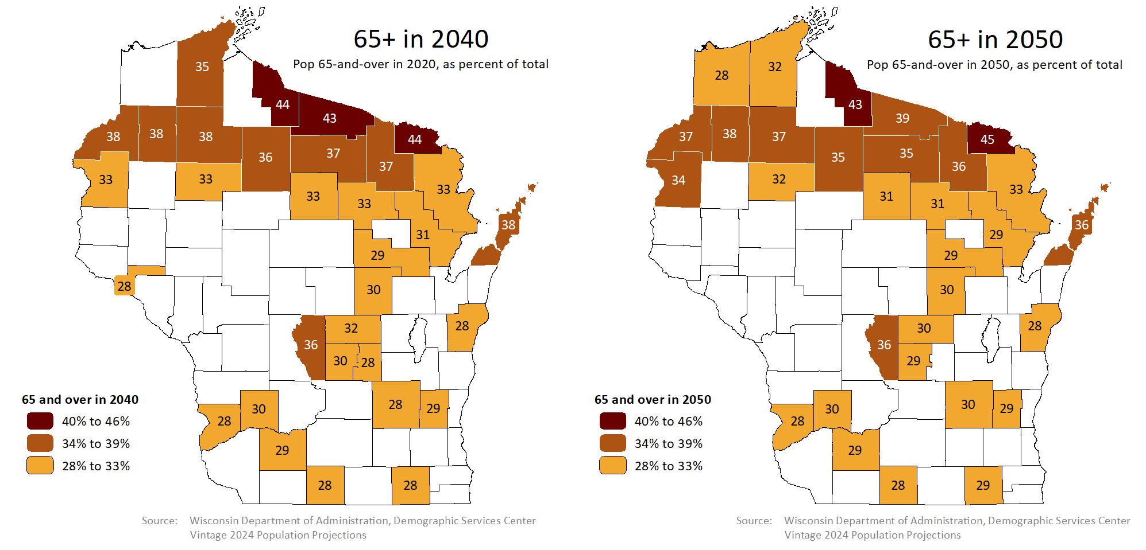
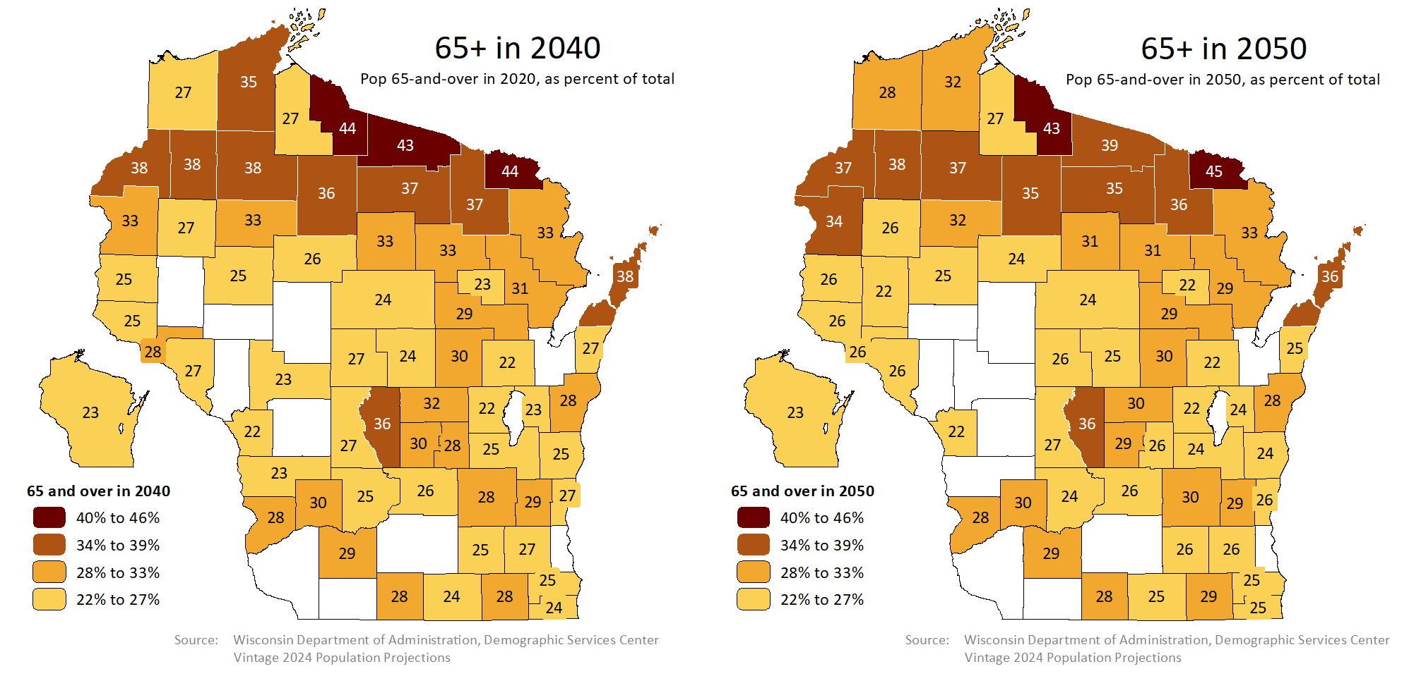
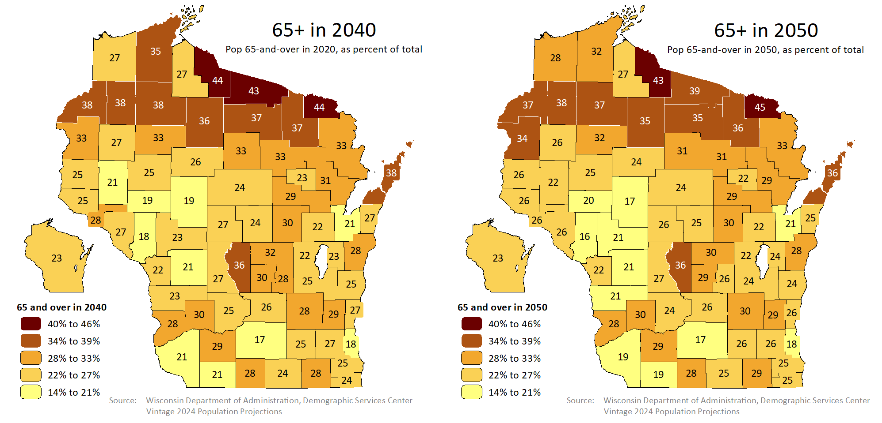

Slide 18
Uncertainty Could Increase
Two components of population change: Natural change = births minus deaths.
Net Migration = in-movers minus out-movers.
Fertility trends and mortality trends tend to be steadier. When net migration
swings from positive to negative (or vice versa), this happens faster, with
less warning, and with less coherent explanation.
Projections confidently suggest that baby boomers will age well past higher-
fertility age groups and enter higher-mortality age groups. This increases the
probability of negative natural change.
If natural change became less of a driver, then irregular changes in net migration
might become a larger share of total population change, increasing uncertainty.

Slide 19
Section 3: Effects of Population Change
Consider income and housing

Slide 20
Income Analysis (relates to age dist.)
The rest of the
story. (See graph
to right.)
Cashing out
your investments
(often in retirement)
Money from a job
you worked or a
business you ran

Slide 21
Income Analysis
Cashing out
your investments
(often in retirement)
Money from a job
you worked or a
business you ran
The rest of the
story. (See graph
to right.)

Slide 22
Investment Income and Transfers
These two components of income, (investment income
and transfers) are both affected by aging populations.

Slide 23
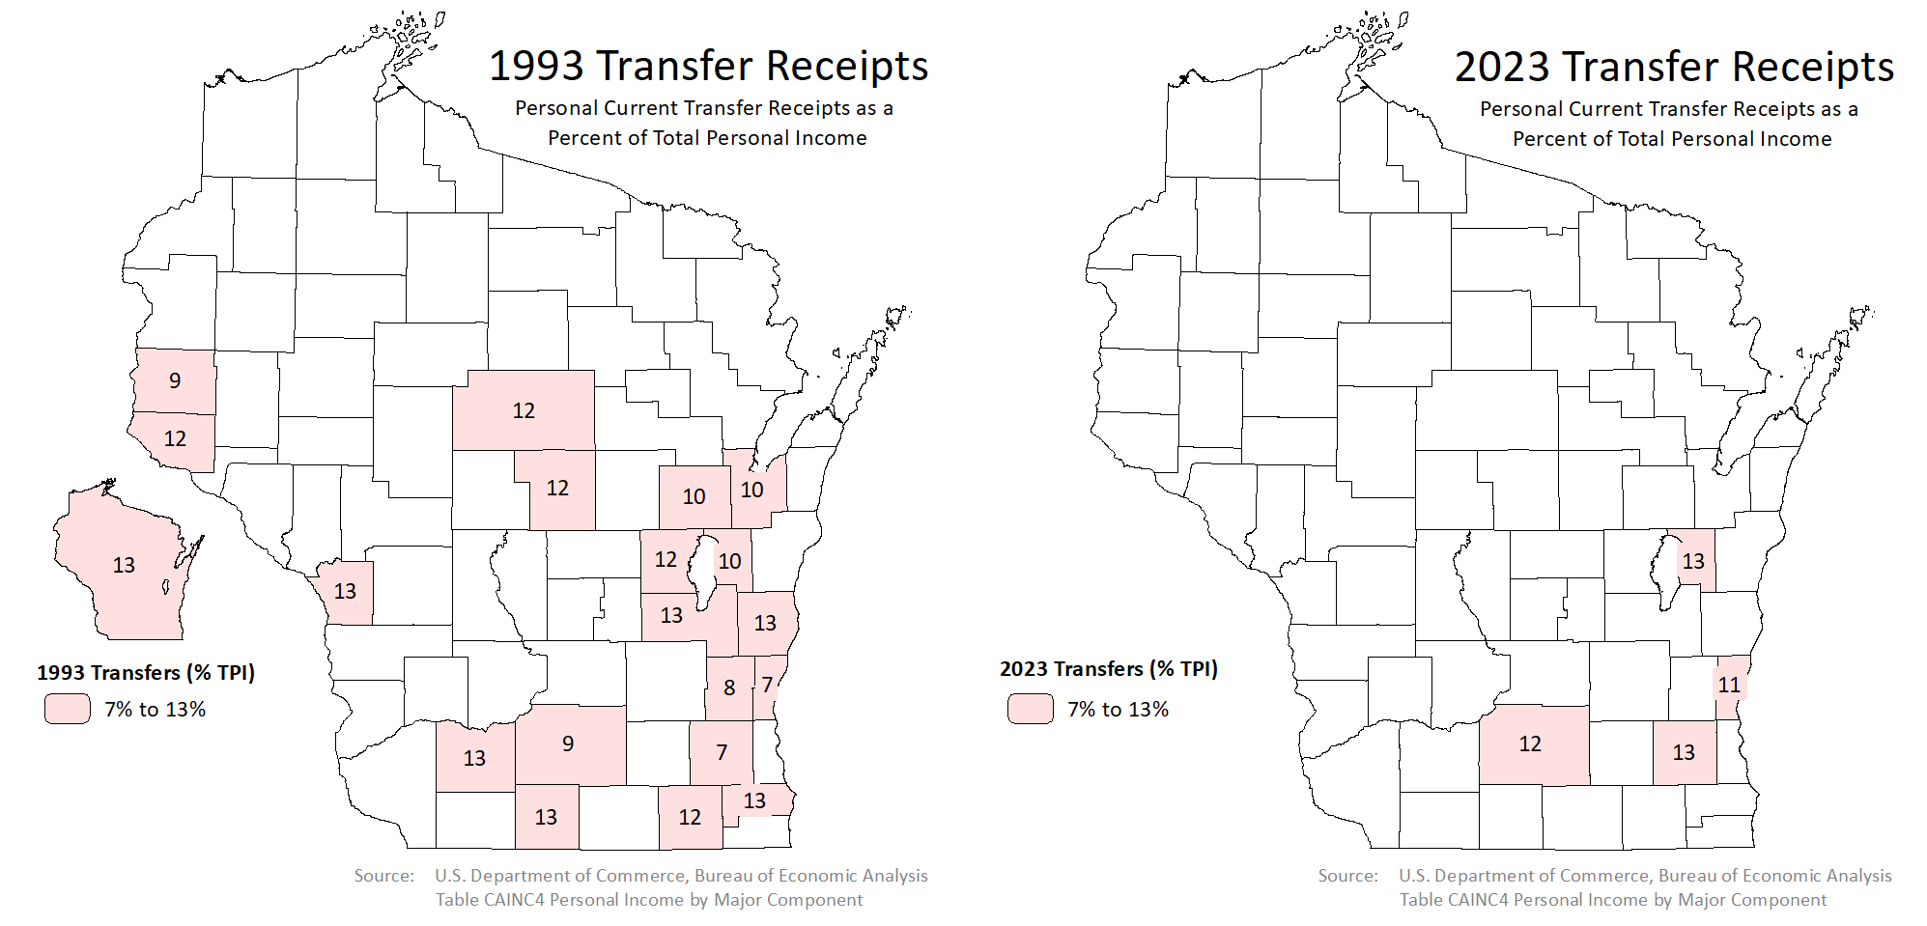
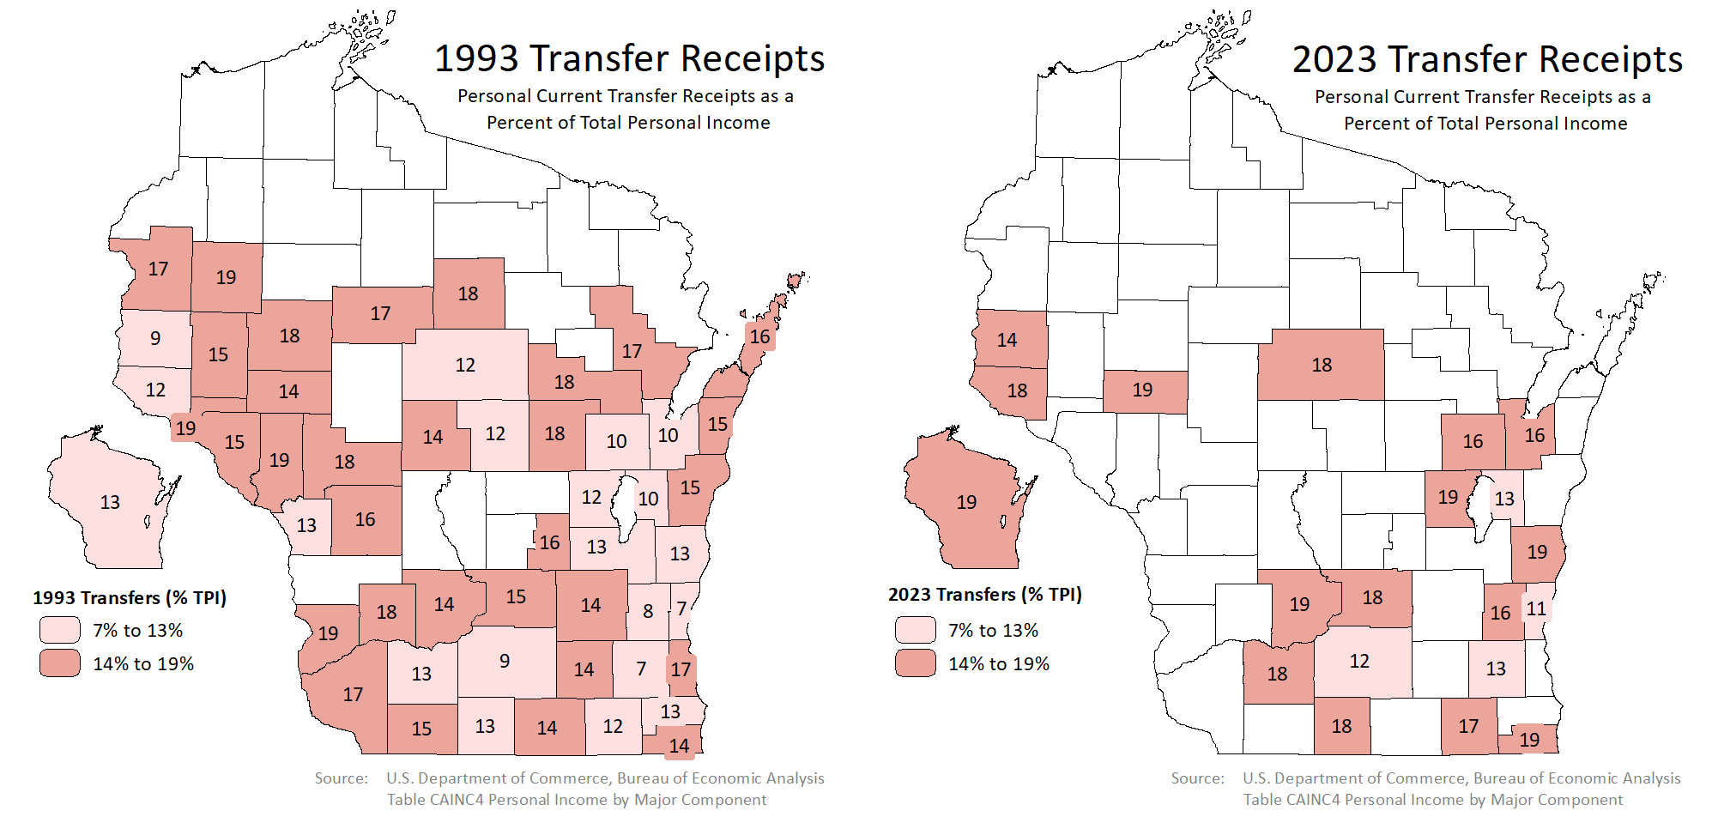
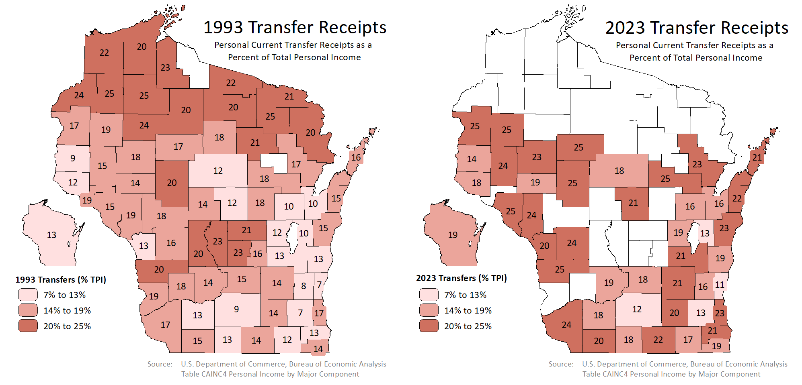
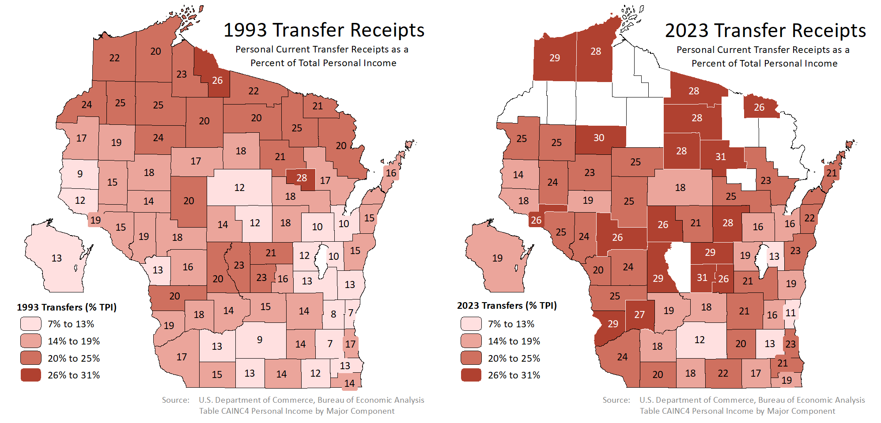
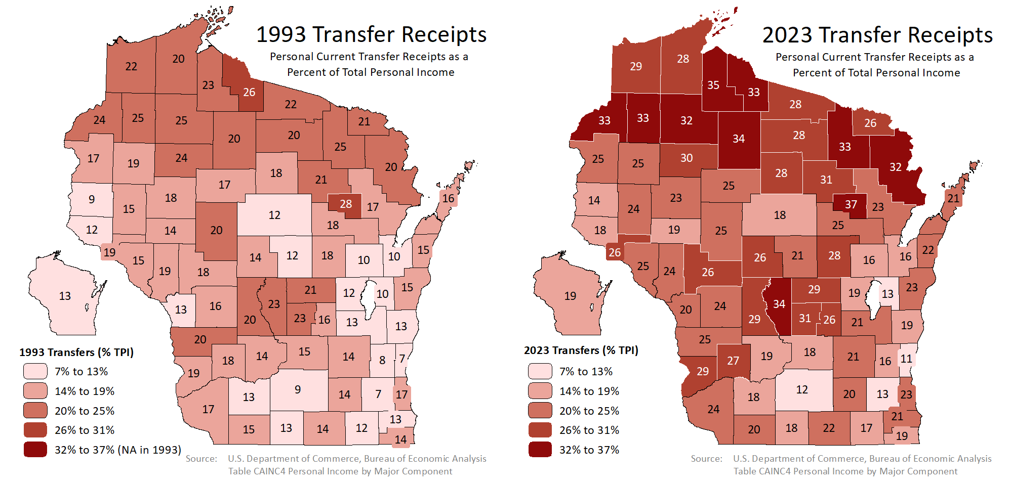

Slide 24
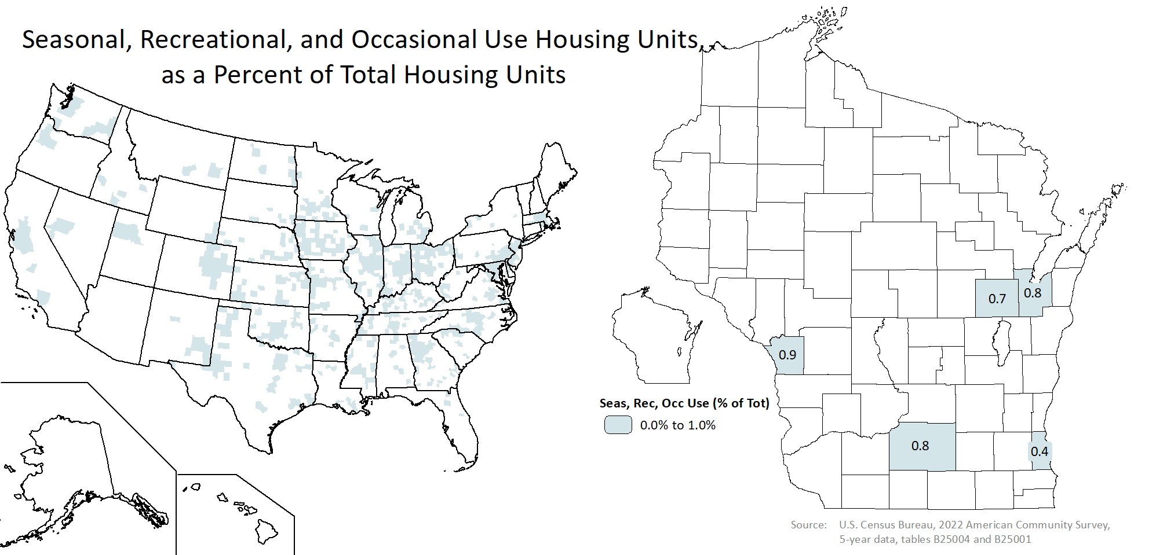
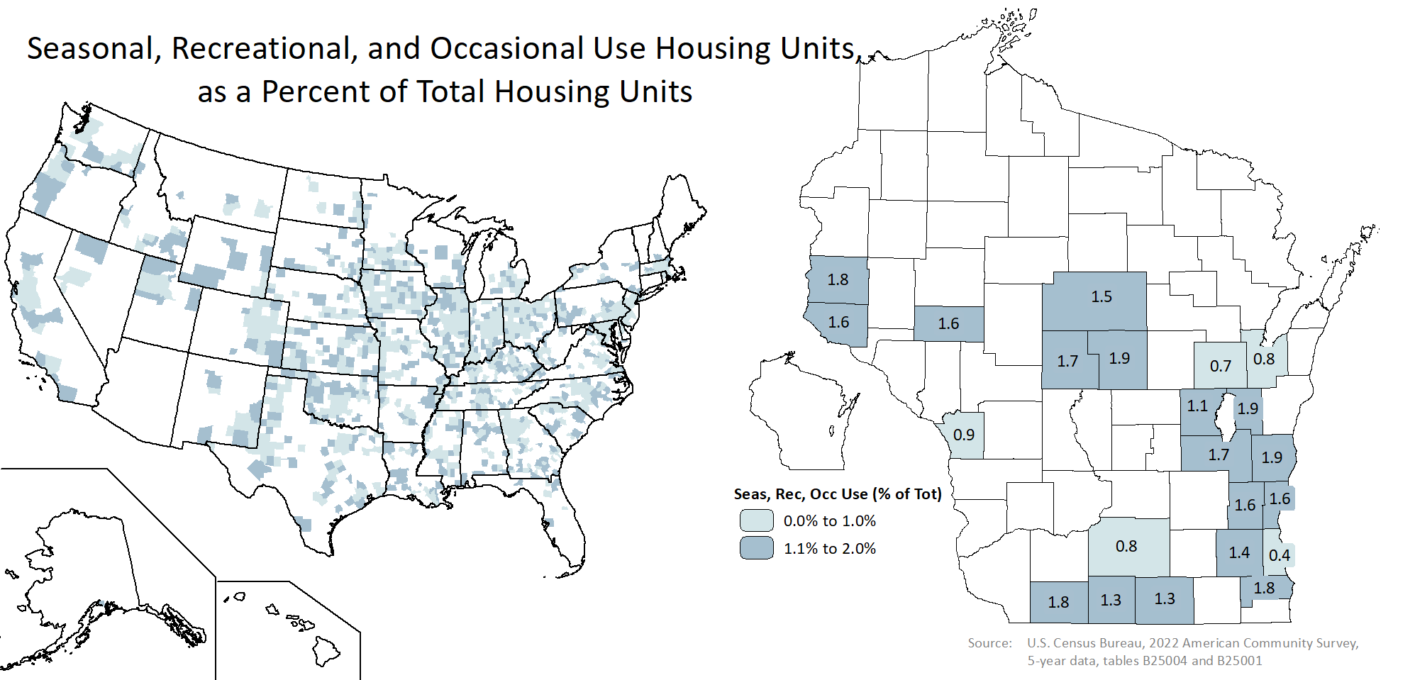
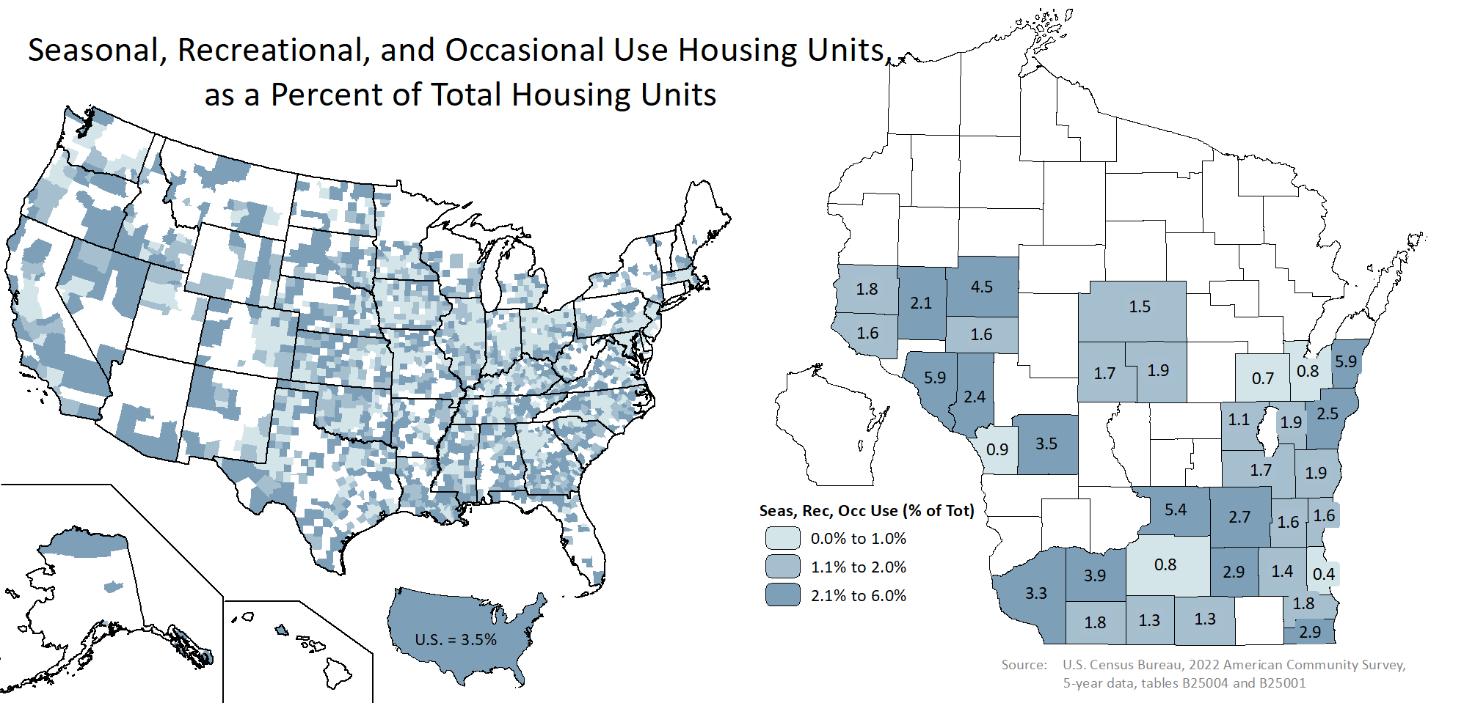
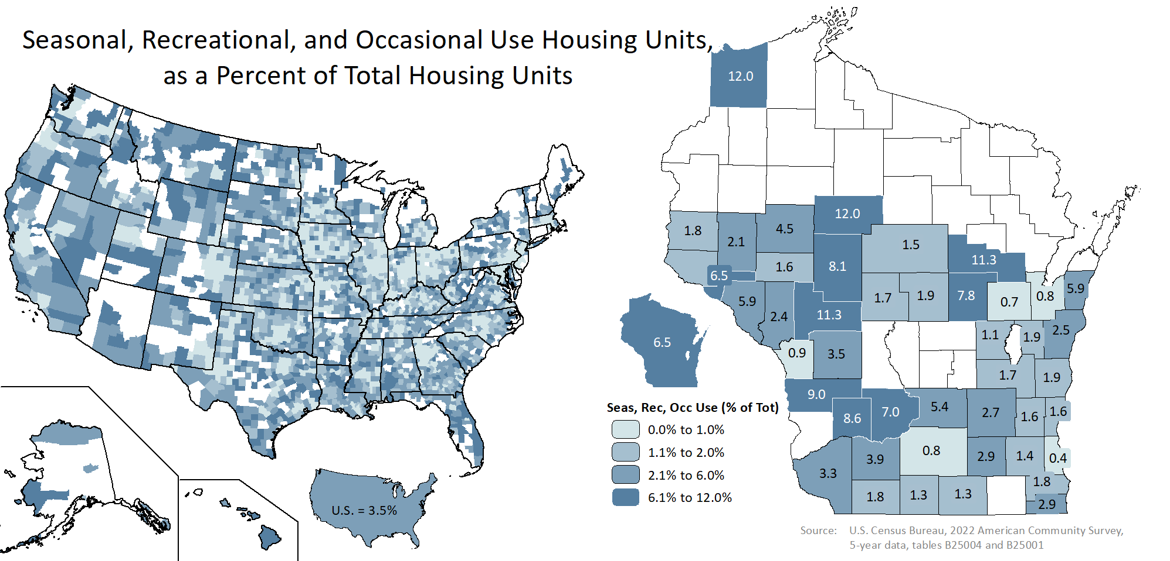
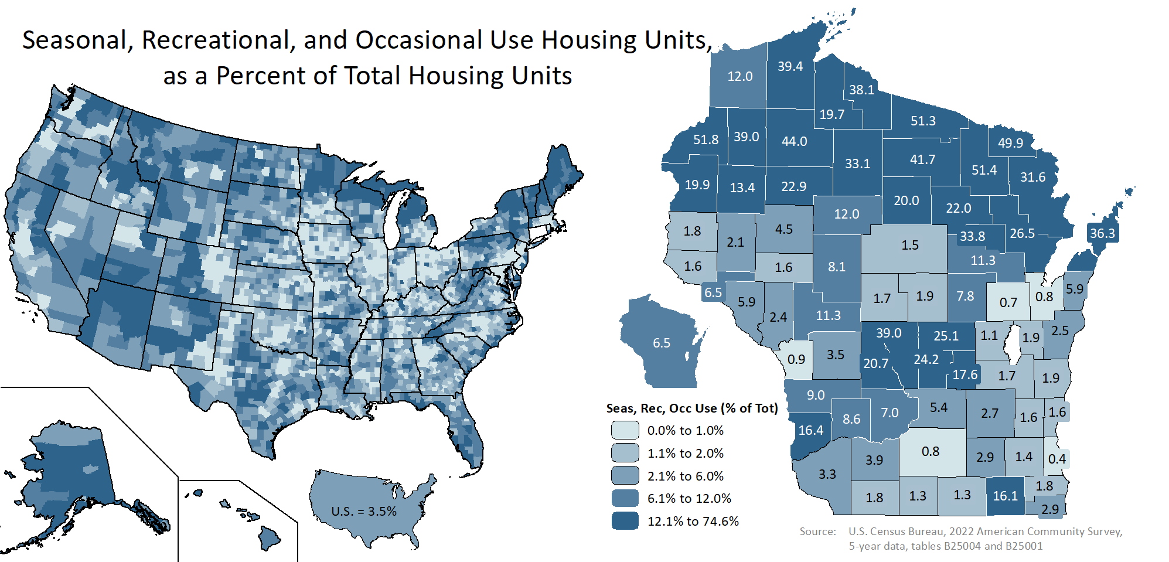

Slide 25
Questions?
dan.barroilhet@wisconsin.gov
(608) 266-1755
https://doa.wi.gov/demographics

