Slide 1
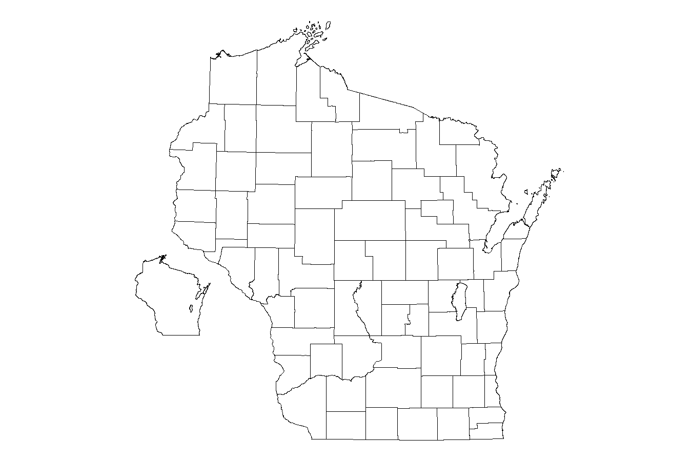
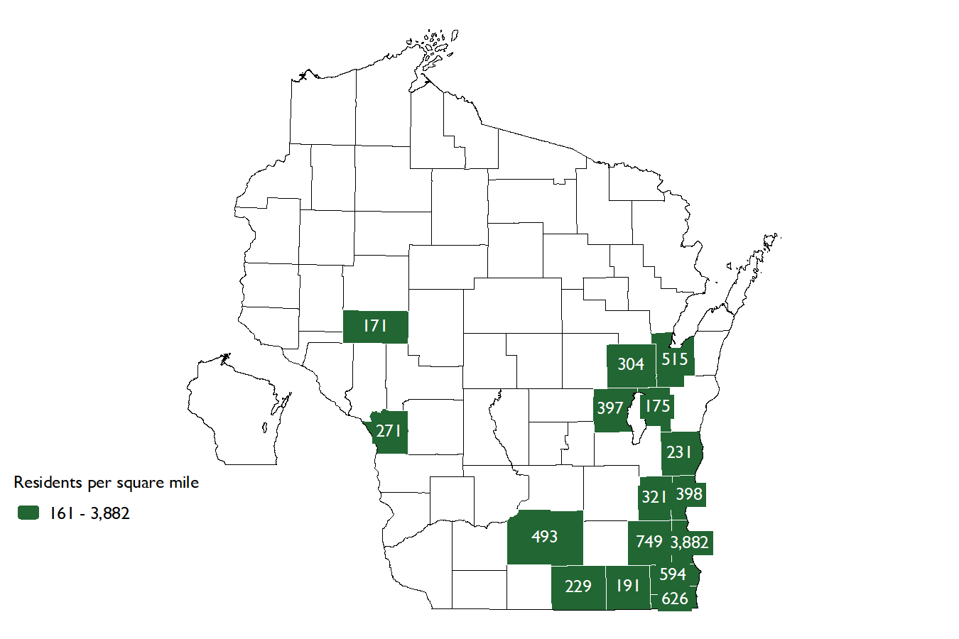
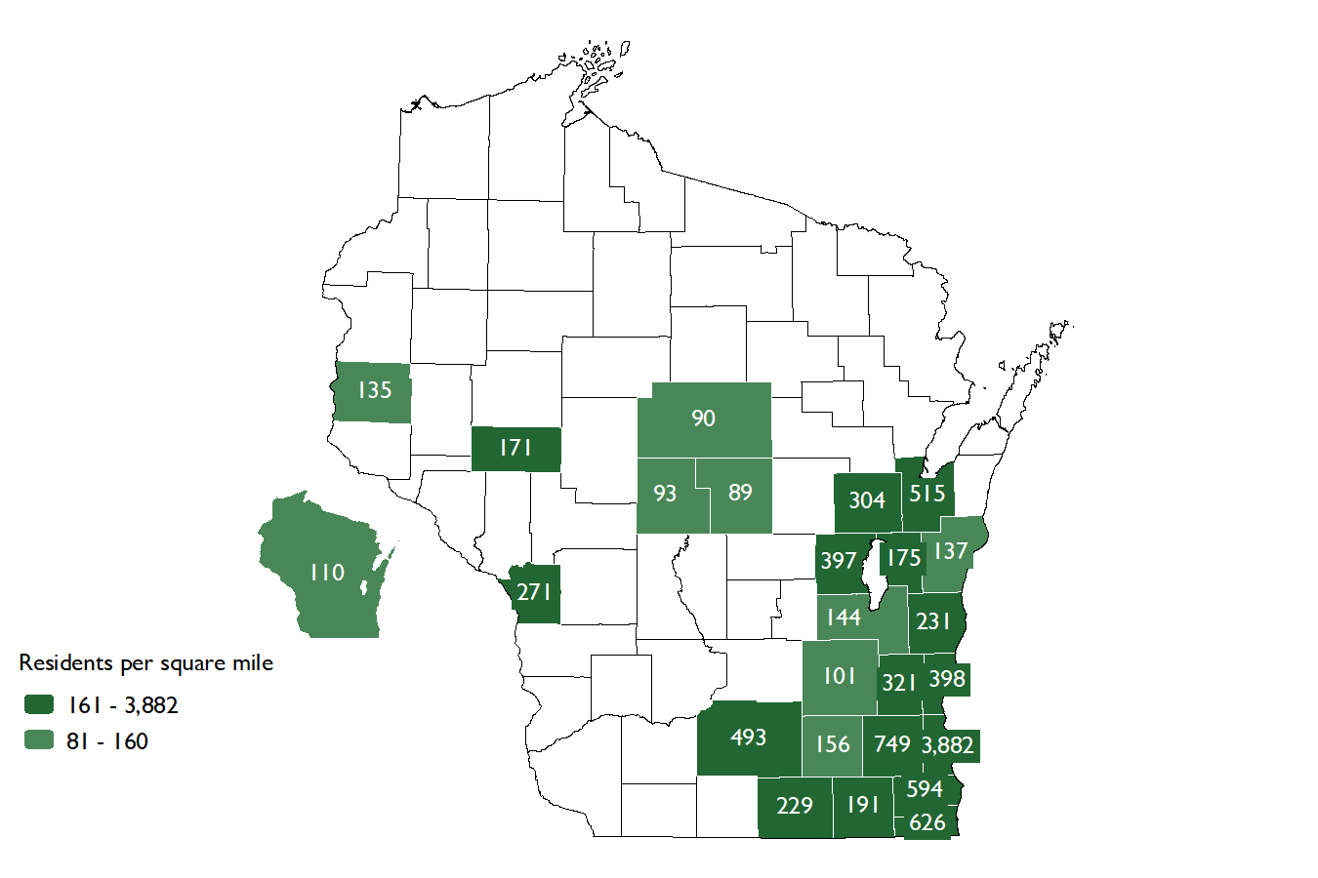
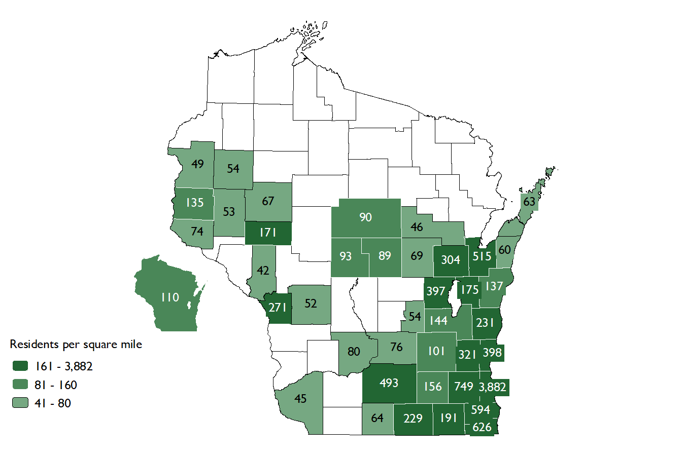
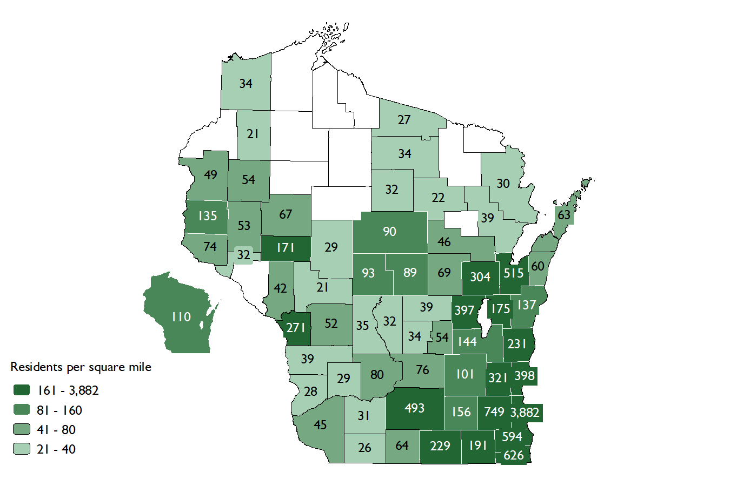
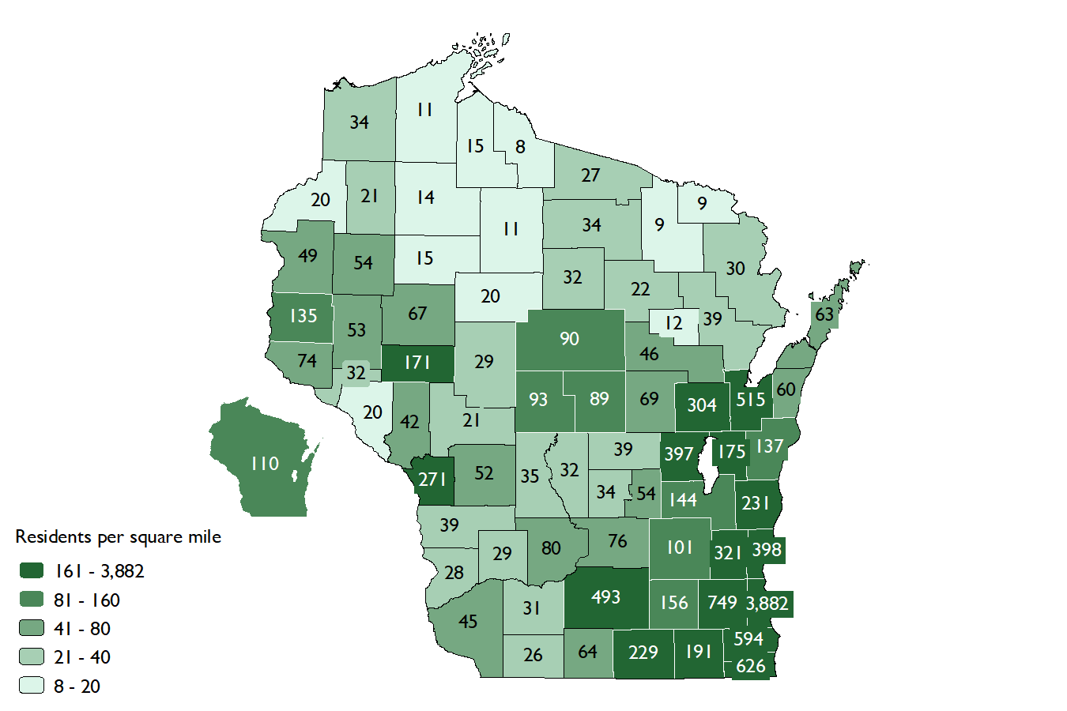
Population Density (Jan 2023 County Estimates)
Sources: Population Estimates by WI Dept. of Administration, Demographic Services Center doa.wi.gov/demographics Land Area from U.S. Census Bureau TIGER Shapefiles

Slide 2
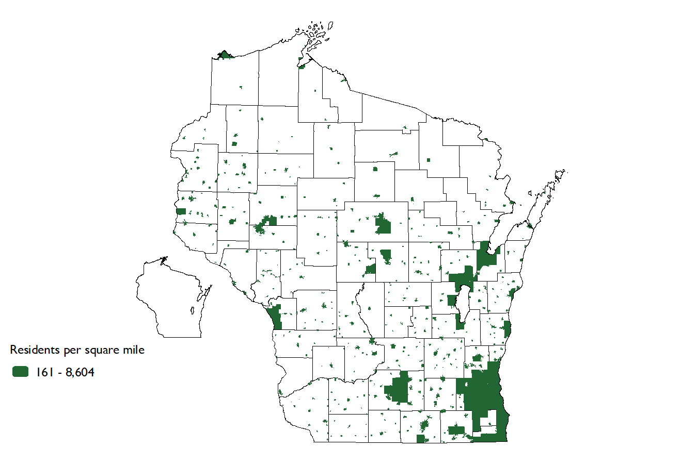
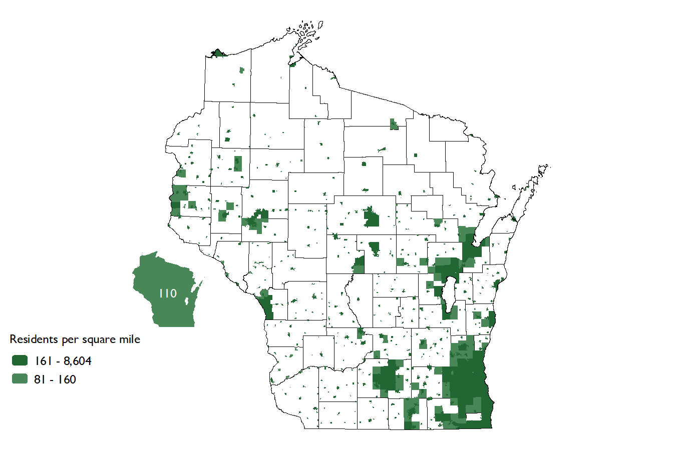
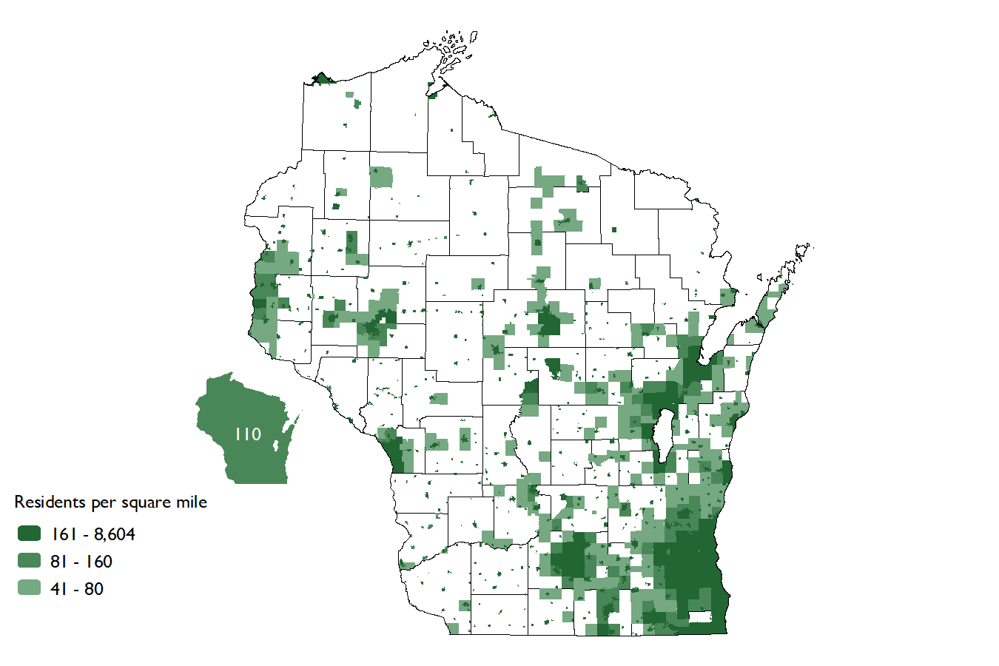
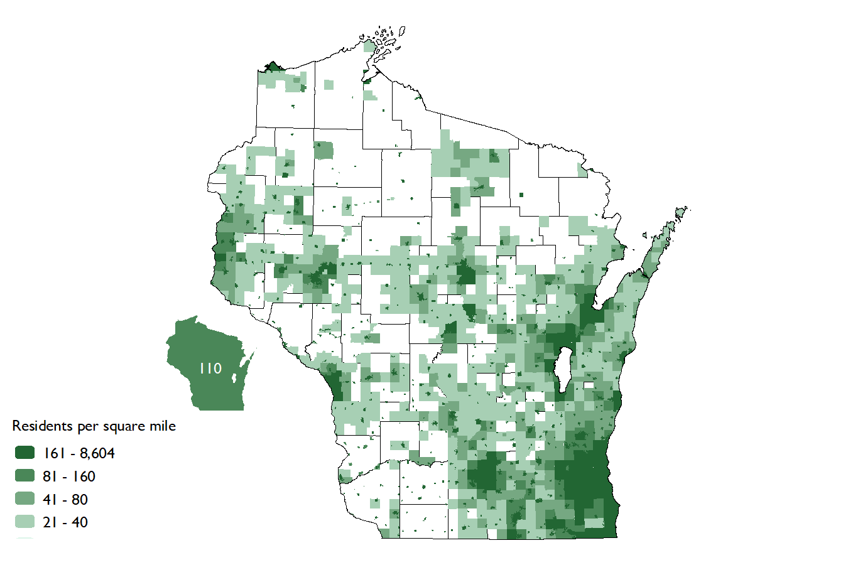
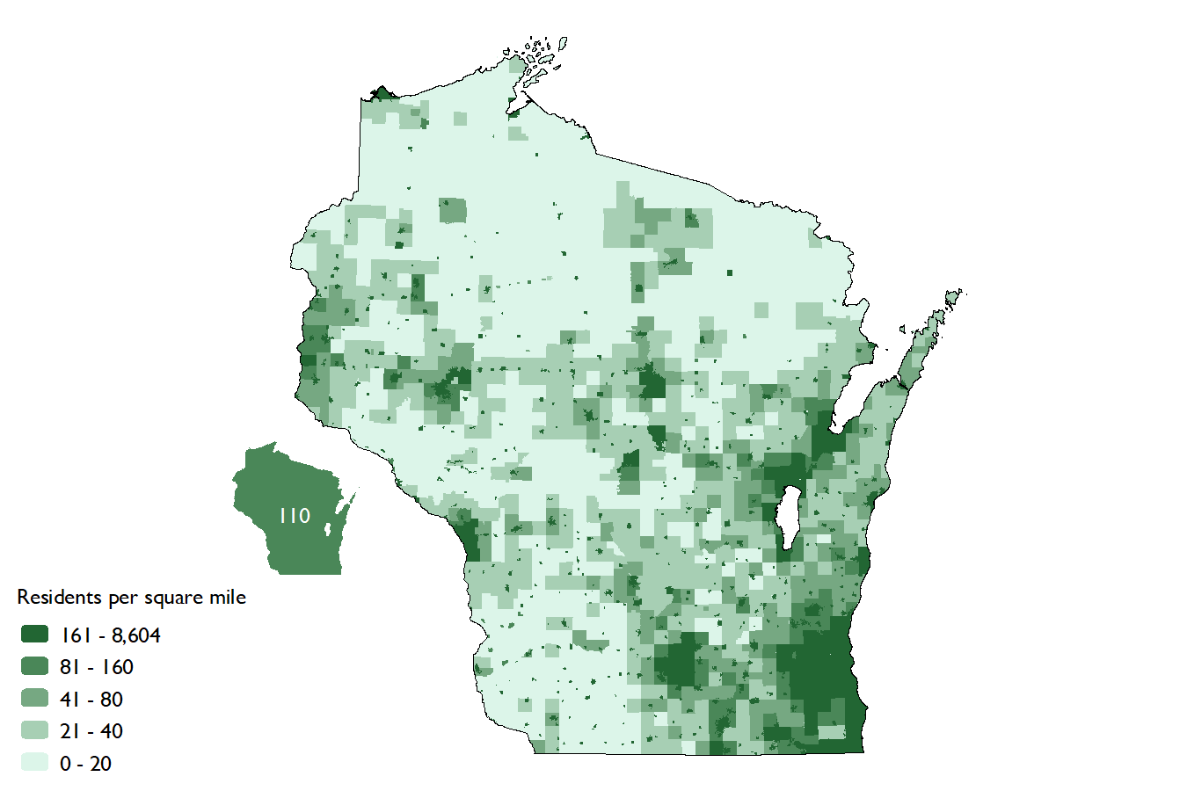
Population Density (Jan 2023 Minor Civil Division Estimates)
Sources: Population Estimates by WI Dept. of Administration, Demographic Services Center doa.wi.gov/demographics Land Area from U.S. Census Bureau TIGER Shapefiles

