Slide 1
Division of Energy, Housing, and Community Resources
Department of Administration
State of Wisconsin
July, 2018

Slide 2
Rental Housing Development (RHD)
In-Service Reporting

Slide 3
What is In-service?
The In-Service report is an annual reporting requirement that is subject to review yearly during a projects affordability period.
The report shall consist of an income/expense operating budget report for the project that covers the previous 12-month period and the current year, as well as audited financials. Grantees will be required to certify that the property has a current insurance policy that identifies Division of Energy, Housing, and Community Resources (DEHCR) as the “mortgagee,” or “additional interest” in the policy declaration page.
In-service is required each year during the period of affordability, to be received on or before April 21st.

Slide 4
Who needs to submit In-Service?
Any project that is still in the Affordability Period is required to submit Annual In-Service reports to remain in contractual compliance with program rules and regulations.
Please refer to your contract if you are unsure if your project is still in the Affordability Period.

Slide 5
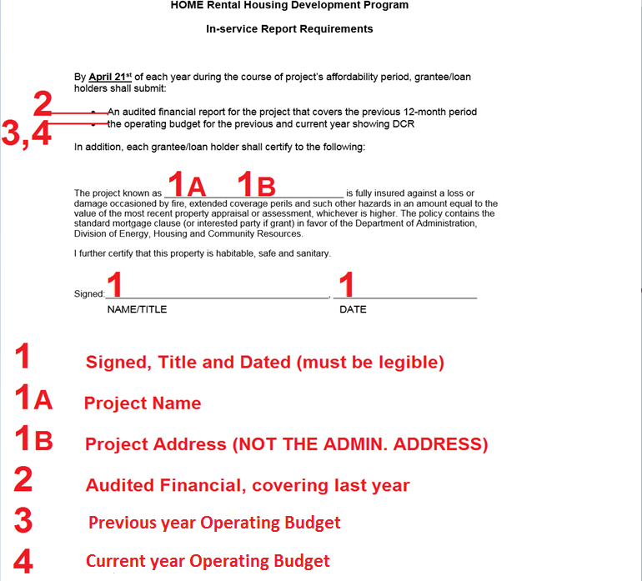
How to fill out the In-service Cover Page
1A=Fill in the Project Name
1B=Project Address (this is the address where the tenants are residing)
1=Signed Name and Job Title, followed by the date

Slide 6
What documents need to be submitted with the In-Service?
1. Audited financials covering the previous 12 month period
2. Operating budget for the previous year
3. Operating budget for the current year
4. The signed In-Service form on the previous page
In-Service Report Requirements Form can be found at https://doa.wi.gov/Pages/LocalGovtsGrants/RHDHomePage.aspx
NOTE: Operating budgets should include Profit and Loss or Debt Coverage Ratio

Slide 7
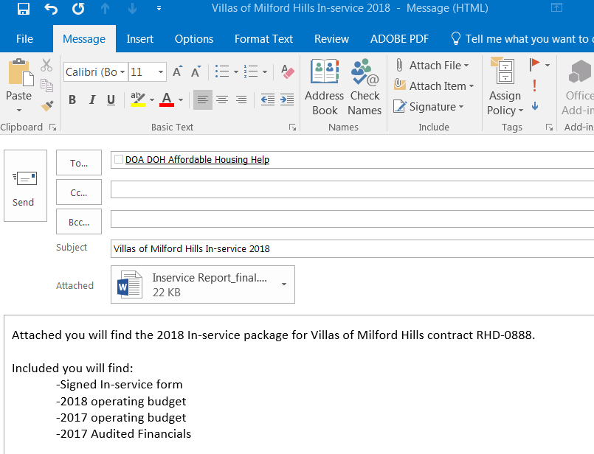
Where to send your In-service Package:
Please send your In-Service Report Requirements form and supporting documentation to DOADOHAffordableHousingHelp@wisconsin.gov
Title your email with the name of your project and In-Service form (see example)

Slide 8
More information:
Please refer to our website under HOME Rental Housing Development (RHD). You will find links with information to the In-Service cover page, as well as any other information needed https://doa.wi.gov/Pages/LocalGovtsGrants/AffordableHousingPrograms.aspx
Questions should be referred to DOADOHAffordableHousingHelp@wisconsin.gov for assistance.

