Slide 1
Division of Energy, Housing and Community Resources Rental Housing Development (RHD) Annual Data Compliance Reporting
November, 2019

Slide 2
What is the Compliance Data Report?
The Compliance Data Report provides tenant data on all HOME assisted rental housing funded by the HOME Investment Partnerships rental program
Collects tenant information about the HOME assisted units only
The RHD Compliance Data Report (Attachment D) covers the period of October 1st through September 30th
An annual report due December 1st
Due for reporting throughout the compliance affordability period

Slide 3
Defining Terms Used Within the Report
The term “Move-In” and “Current” are used to separate between the original occupancy information shown in the first page versus the second page reporting as-of September 30th.
At Move-In relates to when the family or household originally leased the HOME assisted unit
The Move-In information does not change during the tenure of the household
Accuracy in presenting the original information is fundamental to demonstrate that the HOME assisted housing is provided to an eligible household
Utility Allowances are estimates of monthly expenses associated with different types of utilities and end uses
The utility allowance estimate should be reviewed annually

Slide 4
The Report Layout
Page 1 information:
Project Information
Owner Information
Management Company or Compliance Agent Information
At Move-In Tenant Detail
Page 2 information:
Current Tenant Detail as of September 30th
All HOME assisted units are included, even if currently vacant
IF a unit is vacant is should be included, the column for Last Name should indicate “Vacant”
Links to HOME program information and DEHCR RHD email address

Slide 5
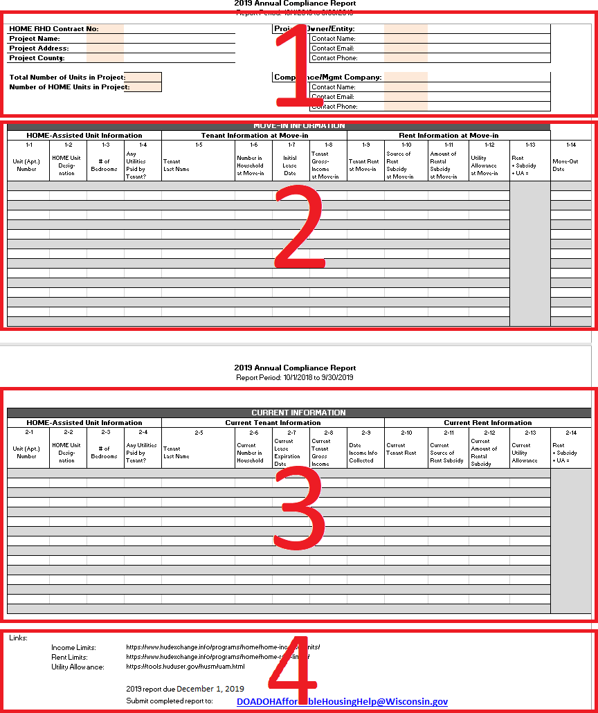
The Report Layout
Page 1 information:
1 – Contact & Project Information
2 – Move-In Information
Columns 1-1 through 1-12
Page 2 information:
3 – Current Information
Columns 2-1 through 2-13
4 – HOME links

Slide 6
Completing the Report: Move-In Information
HOME-Assisted Unit Information
1-1 Unit (Apt.) # The apartment number for the HOME assisted unit
1-2 HOME assisted unit designation
60%,50%,30%, SRO
1-3 Number of bedrooms in the HOME assisted unit
1-4 Any utilities paid by tenant?

Slide 7
Completing the Report: Move-In Information
Tenant Information at Move-In
1-5 Tenant’s last name
1-6 Number of people living in the household at the time of Move-In
1-7 Initial lease date tenants first signed lease to this unit
This date will be used to compare to the HOME income or HOME rent limit for eligibility to the program
Include day, month, and year the tenants first signed lease for this HOME assisted unit
1-8 Tenants income at the time the household originally Move-In; the original income determination

Slide 8
Completing the Report: Move-In Information
Rent Information
1-9 Tenant rent at Move-In, the amount shown on the written lease
1-10 Source of subsidy if applicable at the time of Move-In if applicable
Rural Development, Section 8, etc.
1-11 Amount of Rental Subsidy at Move-In if applicable
1-12 Utility allowance dollar amount at move-in
1-13 A calculation of the Rent, Subsidy and the Utility Allowance
This column is locked from editing

Slide 9
Completing the Report: Move-In Information
1-14 Move-out date if applicable
This is the date the tenant vacated the HOME assisted unit
A date is entered here when a tenant moves out within the October – September reporting period
If the unit remains empty as of the end of the September 30th date, then represent the unit on the second page as “Vacant” in the “2-5 Tenant Last Name” column
In the case a tenant moves in and out of a unit within a few months, this information must be represented in the first page

Slide 10
Completing the Report: Current Information
The second page of the Report is for current tenant and unit data as of September 30th
All HOME assisted units should be reported even if vacant

Slide 11
Completing the Report: Current Information
HOME-Assisted Unit Information
2-1 Unit (Apt.) # The apartment number for the HOME assisted unit
2-2 HOME assisted unit designation
60%,50%,30%, SRO
2-3 Number of bedrooms in the HOME assisted unit
2-4 Any utilities paid by tenant?
2-5 Current Tenant’s last name, or Vacant, as applicable
2-6 Current number of people living in the household

Slide 12
Completing the Report: Current Information
Current Tenant Information
2-5 Current Tenant’s last name, or Vacant, as applicable
2-6 Current number of people living in the household
2-7 Date the current lease expires
2-8 Tenant’s current gross income as of most recent certification / re-certification
2-9 Date of the last, most recent, income re-certification / income determination

Slide 13
Completing the Report: Current Information
Current Rent Information
2-10 Current rent amount as shown on the written lease
2-11 Current source of subsidy, if applicable
Rural Development, Individual Section 8, etc.
2-12 Amount of current Rental Subsidy, if applicable
2-13 Current utility allowance dollar amount
2-14 A calculation of the Rent, Subsidy and the Utility Allowance
This column is locked from editing

Slide 14
Completing the Report: Additional Supplemental Documentation
Upon request, additional documentation may be necessary to review the compliance report, examples include:
Certified Rent Roll
Low Rent Schedule
Utility Allowance Calculations
Copies of Tenant Lease
Income Determination / Certification
Additional Rent Subsidy Benefit Information
Prior Year(s) Compliance Data Reports, if prior year submissions are found missing form project records

Slide 15
Submit your Completed Annual Data Compliance Report
Please send your Annual Data Compliance Report to:
DOADOHAffordableHousingHelp@wisconsin.gov
Title your email with the name of your project and Annual Data Compliance Report
Complete and submit the report in Excel format
Other formats like .pdf will be returned for revision

Slide 16
More Information:
Rent Limits
https://www.hudexchange.info/programs/home/home-rent-limits/
Utility Allowance
https://tools.huduser.gov/husm/uam.html
Income Limits
https://www.hudexchange.info/programs/home/home-income-limits/
Questions should be referred to DOADOHAffordableHousingHelp@Wisconsin.gov for assistance.

